Slide 1
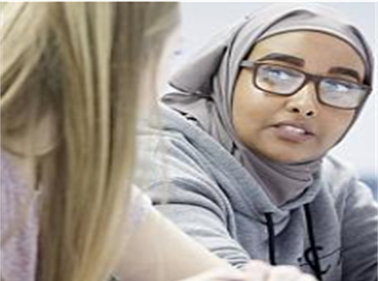
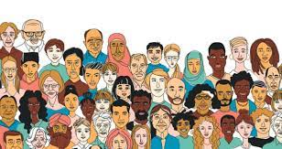
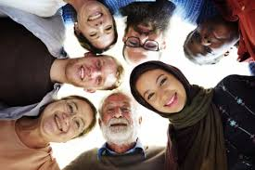
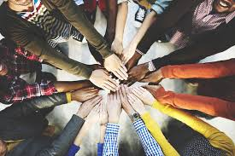
Do we really know who our students are? Understanding, implementing and embedding a culturally responsive pedagogy in our everyday practice Dr Aminul Hoque MBE Goldsmiths College, University of London

Slide 2
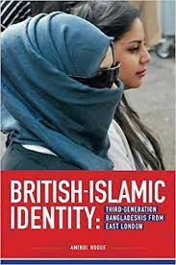
Structure of today’s talk
Draw on my own ethnographic research with young Bangladeshis from London, current work with Goldsmiths’ students & my anti-racist work with the National Education Union (NEU)
Provide insight to some of the everyday ‘lived experiences’ of exclusion and alienation that many BAME students from disadvantaged backgrounds live through
I will argue that these areas of disparity and disadvantage have become even more problematic (and visible) during the Covid-19 pandemic
I will offer some practical ways that educators can ensure that such students remain engaged and enthused in the higher education journey

Slide 3
Key questions
1. Do we really know who our students are? Do/ should we care?
2. Are we aware of the wider social, community and cultural issues that many of our students are living through?
3. How do we get to know our students and ensure that their views, interests, lived experiences, aspirations inform and guide our pedagogical practices?

Slide 4
Culturally sensitive pedagogy
In light of neoliberal reforms to education, there is a need to revert back to a more inclusive and collaborative form of education where the line between the school and the community is blurred and where the complex cultural, linguistic, ethnic, gender and religious identities of our pupils are explored within the curriculum. As a teaching philosophy, a culturally responsive pedagogy is premised on the idea that valuing culture is central to learning. Educators cannot trivialise or pay token attention to the cultural world and lived experiences of their pupils, and instead take time to understand their pupils and their sociocultural worlds, listen to them as well as valuing and maintaining their cultural identities and heritage within pedagogical practices. Such an approach empowers pupils intellectually, socially, emotionally and politically (Hoque, 2015b, 2018; Lucas and Villegas 2013; Nieto 2000).

Slide 5
Students/ pupils/ young people do not leave their sociocultural worlds and identities behind once they enter the school gates – and nor should they!
(Bullock Report, 1975)

Slide 6
‘Ideal’ univeristy student – key characteristics/ background required
(relative) financial stability. Flexibility. Access to networks of ‘critical’ friends. Literate (‘professional’) parents/ siblings. Access to stationery/ digital equipment/ wi-fi/ homework space etc. Confidence to ask questions. Knowledge of the university (HE) system. Ability to read CRITICALLY. Career plan? Time (to ‘hang out’ at university and not always rushing to get home; to do my reading and not feel ‘tired’ all the time). Not having to work (help family, pay for mobile bills/ travel). Well travelled (‘worldly’). Independent study skills.

Slide 7
Case study – Fatima, aged 19, female, Bangladeshi, from London. Wants to become a teacher. ‘My typical week’.
I love my family and my very close-knit Bangladeshi community. My culture and community mean a great deal to me, although it can be sometimes overwhelming – the private is nearly always public. I have a large family. I am the second oldest of 5 siblings, and also the first person to go university (a great source of pride for my family). So the pressure is on! My parents are amazing and super-supportive, but are always busy managing the house. My father grew up in Bangladesh and cannot speak much English. He is always working all sorts of hours in a grocery store. My mum is a housewife and also has a disability which means that my older sister and I have to help out a lot at home. It is chaotic at home, but I love it. I share a room with 2 of my sisters, and we are constantly fighting for the one working laptop that we have. My grandparents also live with us and frequently I have to take them for hospital appointments because I can speak English. And often, either myself or my older sister have to drop my younger siblings off to school and pick them up. My day starts at 6.30am because I have to get them ready for school and then rush to university to make the 10am lecture. And then I’m rushing back afterwards for the pick up. Oh did I also tell you that I am online for Arabic classes everyday between 5-7pm, and I have a part-time weekend job. I am always ‘running’ and ‘juggling’. ‘Multitasking’ has become part of my identity.

Slide 8
What barriers/ challenges/ opportunities can you identify?

Slide 9
The intersectional ‘lived experiences’ of many students from BAME backgrounds
These pupils also happen to come from low income socio-economic backgrounds and also have been disproportionately affected (recently) by the Covid-19 pandemic.
The wider empirical research highlights that many of these students have an intersectional lived experience focused around cultural barriers to higher education, part time employment commitments, care responsibilities, apathy towards wider university social education, poverty of (low) aspirations (Archer et al, 2010; Hoque, 2015a, 2018).
These students are also overwhelmingly of Muslim/ Islamic background and there is an additional institutional and societal barrier of discrimination (Islamophobia) that they need to negotiate? (Allen, 2010; Shain, 2003, 2010; Hoque, 2015a, 2018).

Slide 10
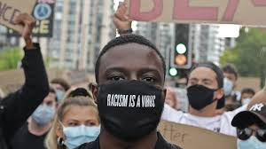
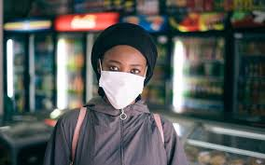
Covid-19 – a working class reality
Intergenerational households
Overcrowded houses
Digital poverty
Caring responsibilities (cultural)
Service sector employment (‘too nice & compliant’)
Mistrust in the health service (‘institutionalised’ racism) -Discrimination
Underlying health issues?
Mental health

Slide 11
The situation at Goldsmiths, Educational Studies, 3 year plan.
Management – establish a sub-committee to explore these issues further | Identify issues/ Research – in partnership with students. ‘Listen’ to their stories
Student voice – facilitate voice & visibility in lecture halls | Staff training & role of PT’s – provide insight & understanding of ‘lived experiences’
Study & reading circles – to encourage critical reading | Mentoring – with ex-students from same demographic
Outreach – work with secondary schools & community groups | Assessment – incorporate more alternative methods (visual, verbal, presentations etc)
Inclusive teaching – lectures, readings, discussions to reflect diverse student population | Grants & scholarships – identify areas where students can access financial assistance

Slide 12
The debate continues……. Stay in touch Dr Aminul Hoque Department of Educational Studies Goldsmiths, University of London E: a.hoque@gold.ac.uk Twitter: @BrIslam2015

Slide 13
Questions?

Slide 14
References
Allen, C (2010) Islamophobia, Farnham: Ashgate
Archer, L., Hollingworth, S., & Mendick, H (2010) Urban Youth and Schooling, Maidenhead: Open University Press
Bullock, A (1975) A Language for life. The Bullock Report. London: Her Majesty’s Stationery Office.
Hoque, A (2020) ‘Research to reflect on: developing a culturally responsive pedagogy’. National Education Union NEU. https://neu.org.uk/media/11431/view
Hoque, A & Keelan, A (2020) A Very British History: British Bangladeshis. BBC4, Jan 2020.
Hoque, A (2018) ‘Third-generation British-Bangladeshis from east London: complex identities and a culturally responsive pedagogy’, British Journal of Sociology of Education, 39:2, 182-196, DOI: 10.1080/01425692.2017.1406335
Hoque, A (2015a) British-Islamic Identity: Third-Generation Bangladeshis from East London, London: IOE/ Trentham Press
Hoque, A (2015b) ‘Knowing our students’ identities: British Bangladeshis in east London schools’. Race Equality Teaching 33(1): 16-21
Lucas, T., and A. M. Villegas (2013) ‘Preparing Linguistically Responsive Teachers: Laying the Foundations in Preservice Teacher Education’, Theory into Practice 52: 98–109.
Nieto, S. (2000) ‘Placing Equity Front and Center: Some Thoughts on Transforming Teacher Education for a New Century’, Journal of Teacher Education 51: 180–18
Shain, F (2010) The New Folk Devils: Muslim Boys and Education in England, Stoke-on-Trent: Trentham Books
Shain, F (2003) The schooling and identity of Asian girls, Stoke-on-Trent: Trentham Books

