Slide 1

Participatory Arts Methods for Engaging Young People in Climate Research
Dr. Miranda Matthews, Bridget McKenzie and Kevin Davidson

Slide 2
CAL and CMUK Ecologies in Practice
Context
Intentions
Research design:- methods, approaches, practice researchers and participants
Difficulties and Discoveries in practice research
Key points for empowering young people in the Earth Crisis via participatory arts methods

Slide 3
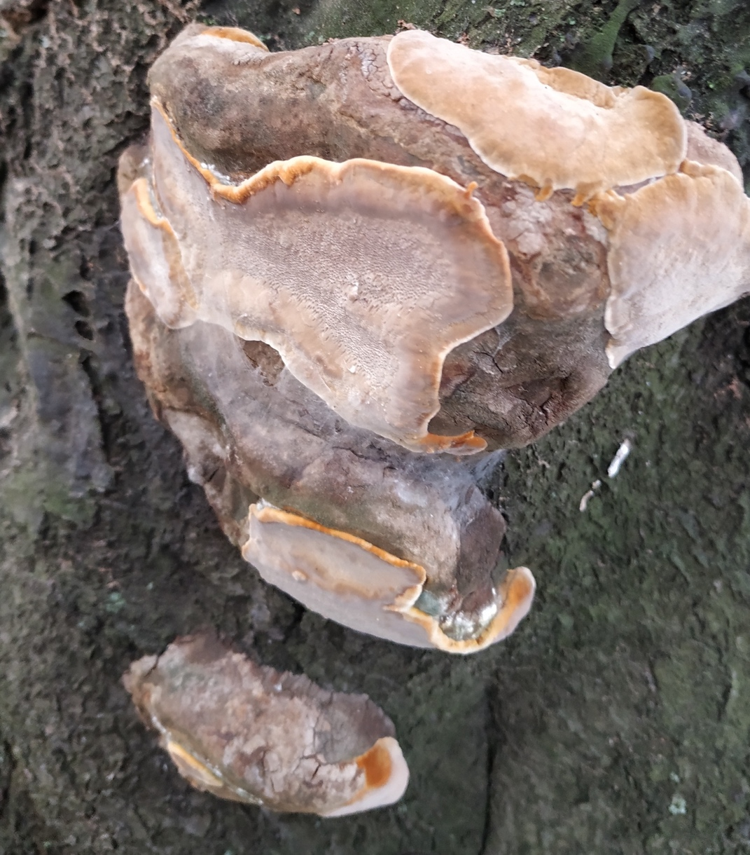

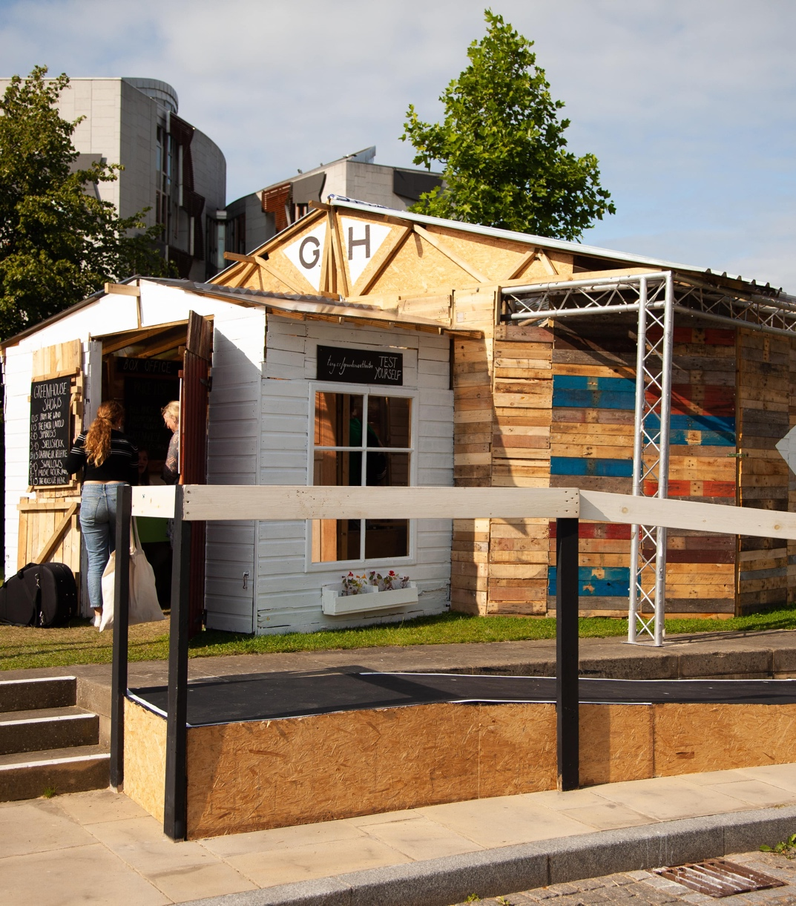
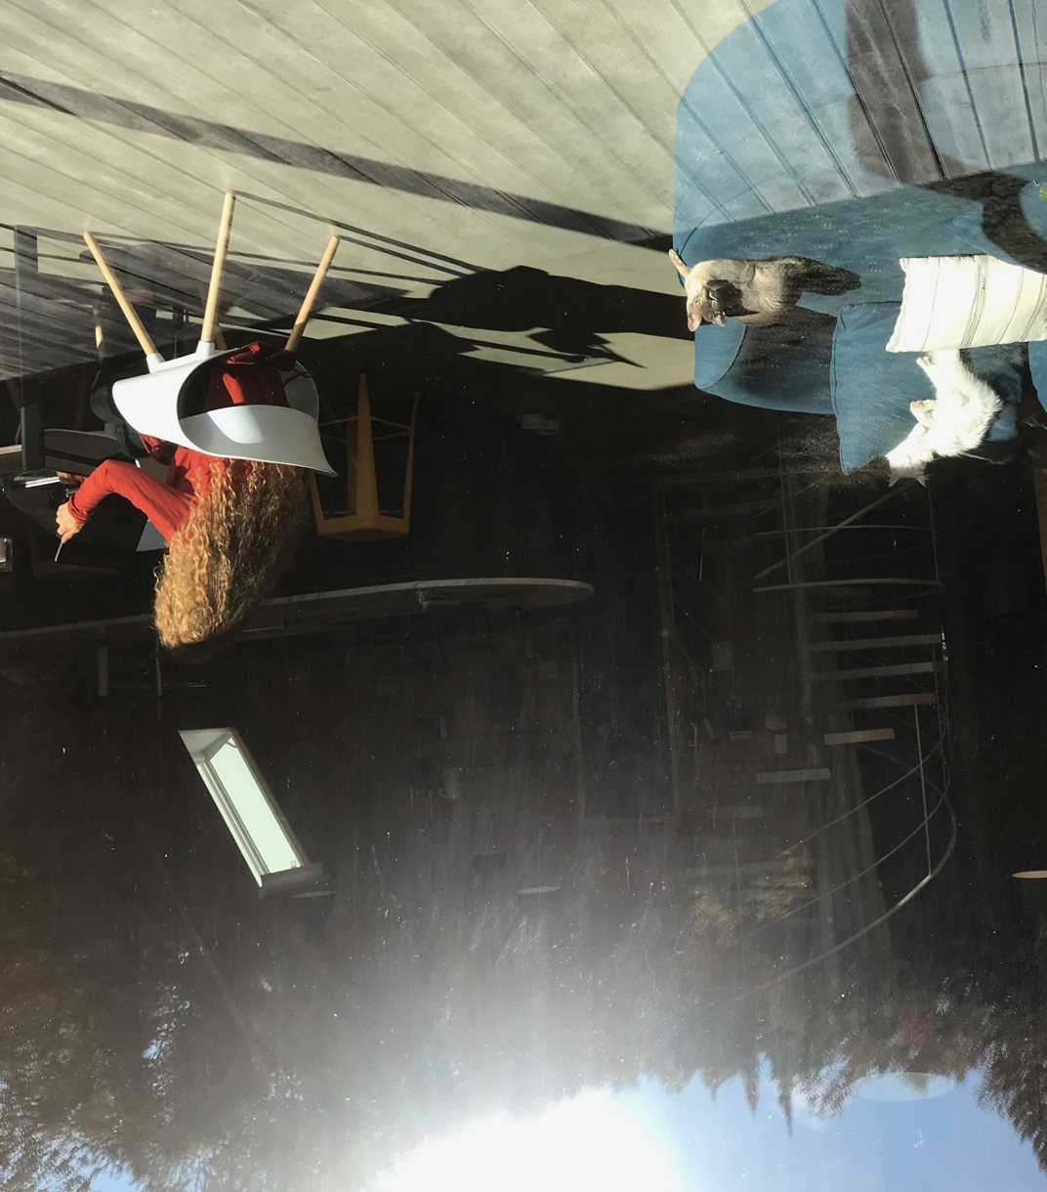

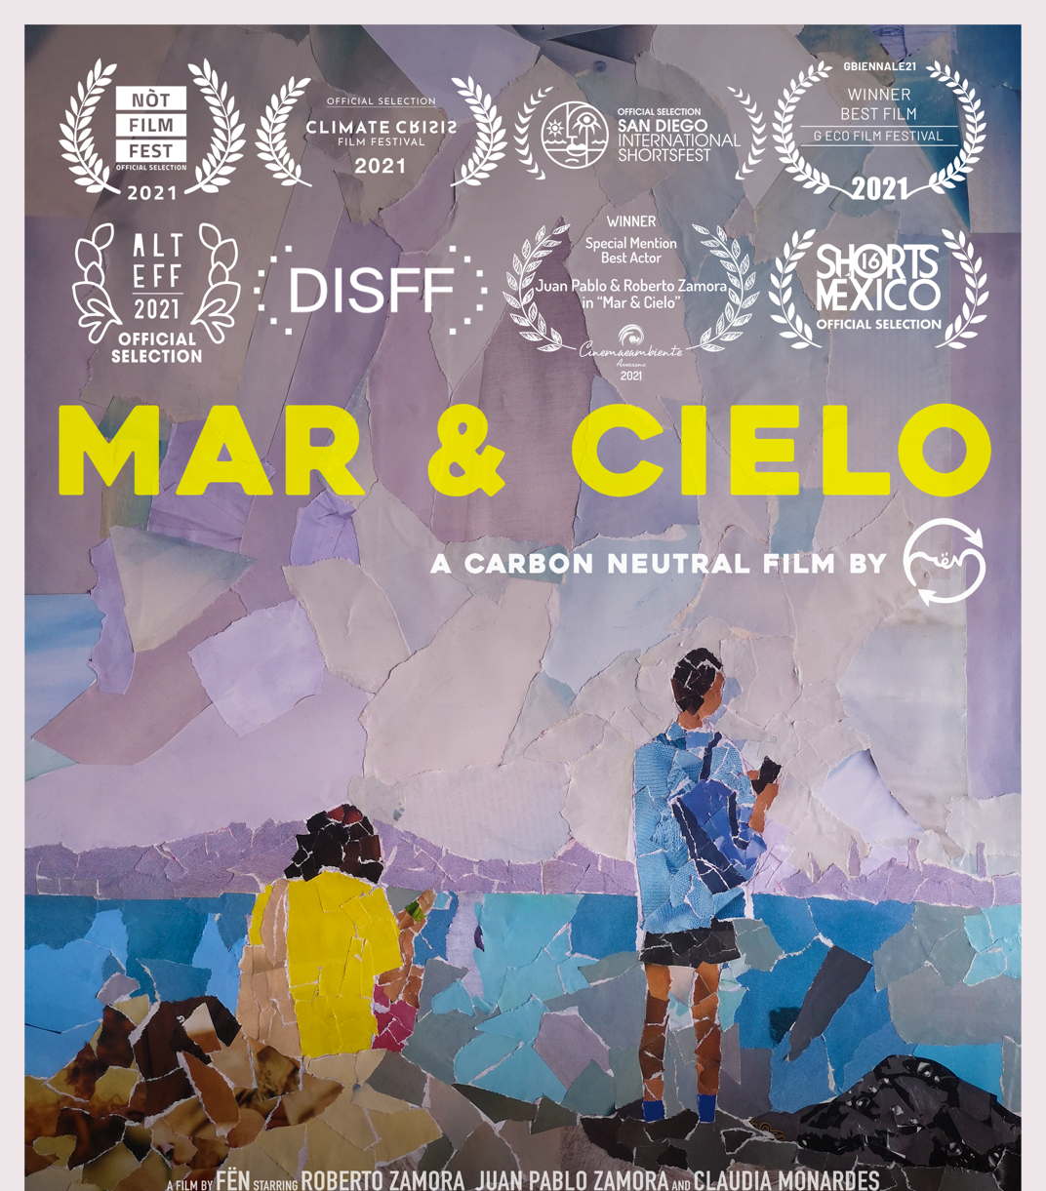
Context CAL
Centre for Arts and Learning Ecologies in Practice research started in 2021

Slide 4
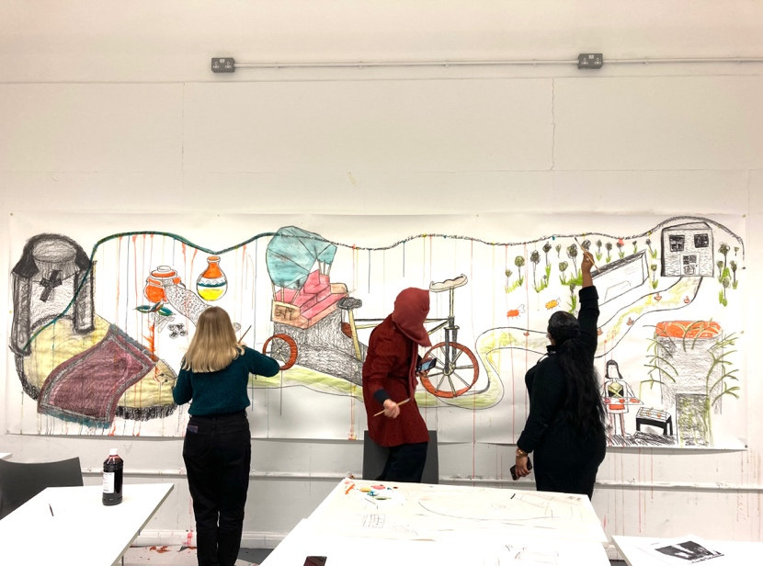
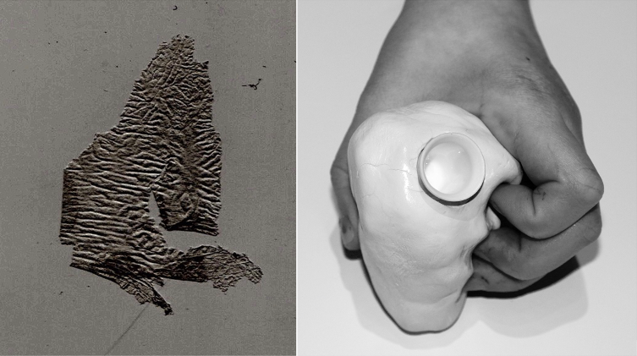
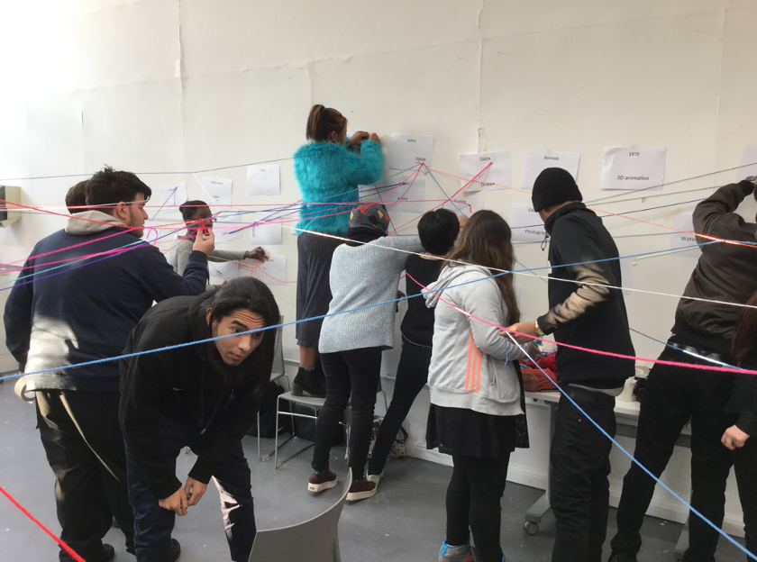
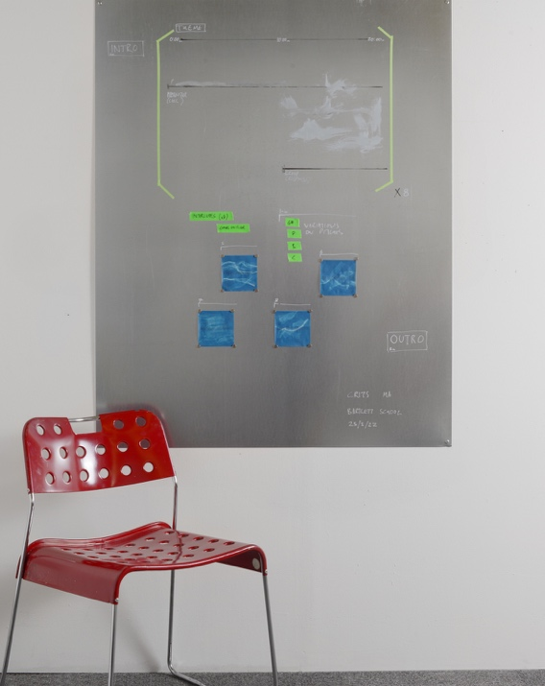
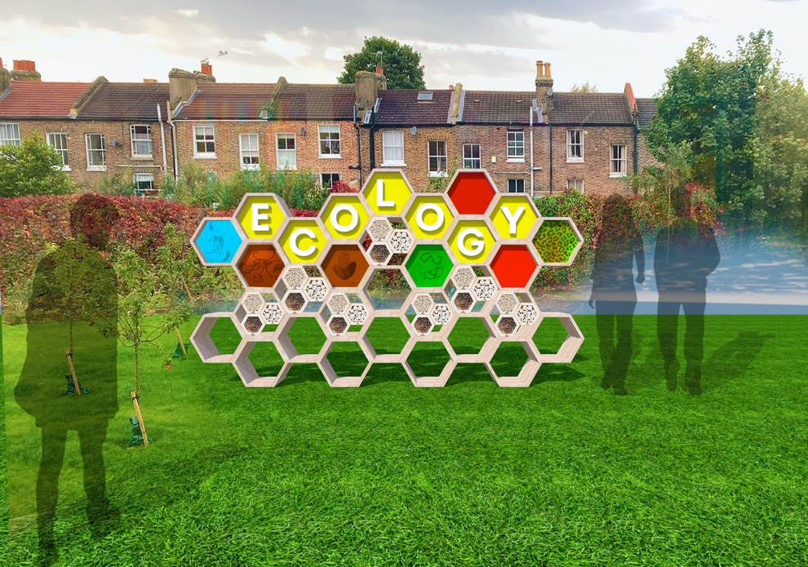
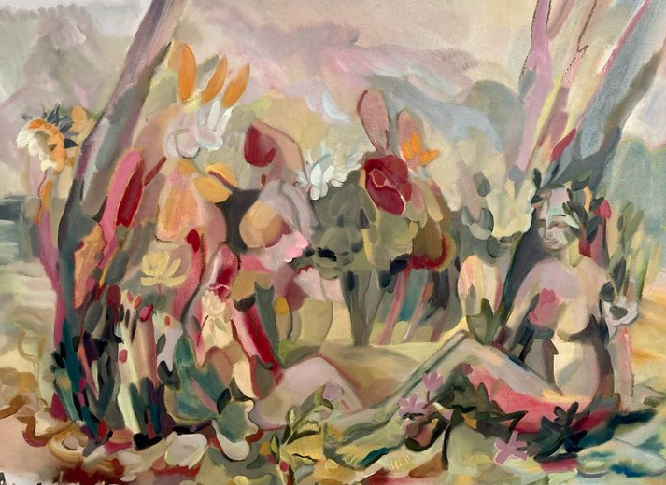
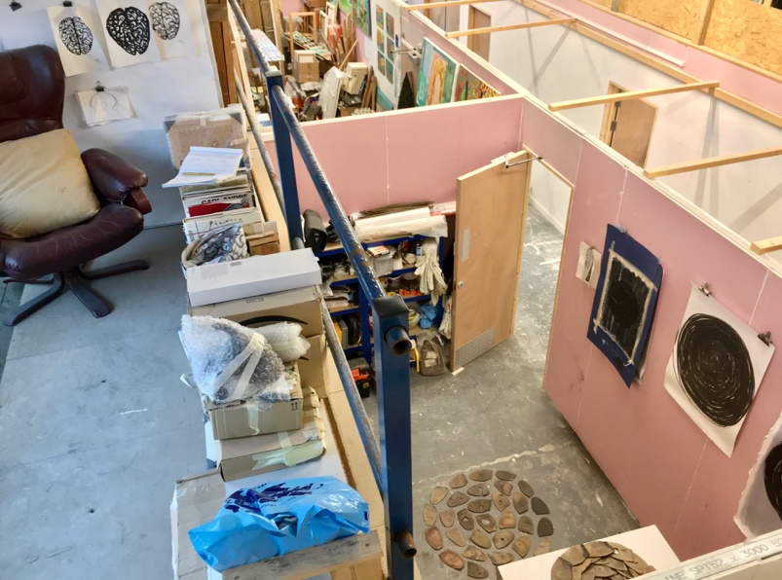
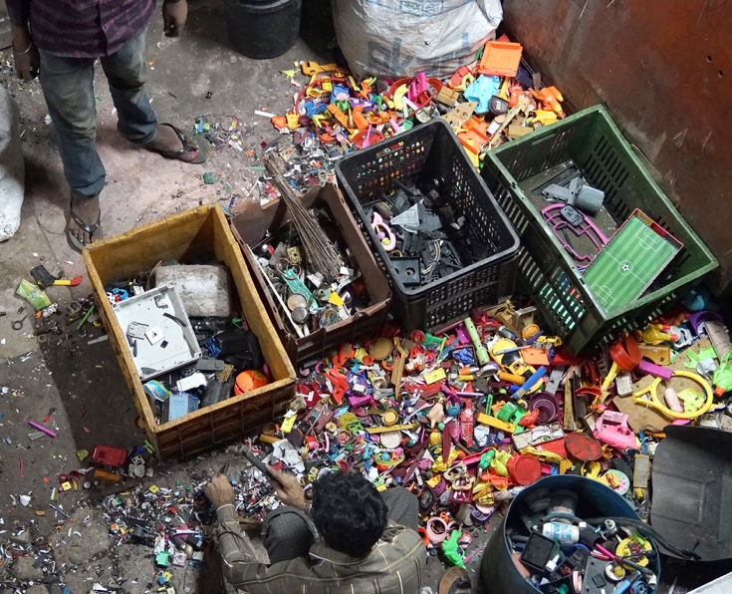
A range of events, two symposiums, then CAL and CMUK started planning to include young people in practice research

Slide 5
Intentions to…
Research how interventions in arts practice can enable young people to express agency around the issues involved in climate change.
Focus young people's attention on creative responses to biodiversity loss, environmental relationships to culture, and dialogical nature-based solutions to climate change that connect with the needs of different communities.
Develop shared knowledge of 'cultural ecologies’, and investigate how culture can create restorative interventions in climate change through the arts and learning.

Slide 6
Intentions to…
Resource young participants with 3 arts methods for engaging peers with climate science and Earth Crisis evidence, exploring and evaluating potential solutions in a series of events.
Participants can take these methods forward in their own projects at school and at university.
Make opportunities for young people to engage creatively, enabling vocal participation and a high degree of freedom, in learning environments that encourage respect for difference and an ethics of care for one another (Atkinson 2018).

Slide 7
Intentions to…
Explore local and global food systems and diverse cultural relationships with the Earth's resources (Jagodzinski 2018, De la Cadena and Blaser eds. 2018).
Develop adaptive pedagogies, based on strategies that we have already found to be effective in engaging young people with creative learning, to see how these approaches can build Ecologies in Practice.
Provide data that will input to the development of creative learning resources for schools, universities and Climate Museum UK, encouraging widening participation in research.

Slide 8
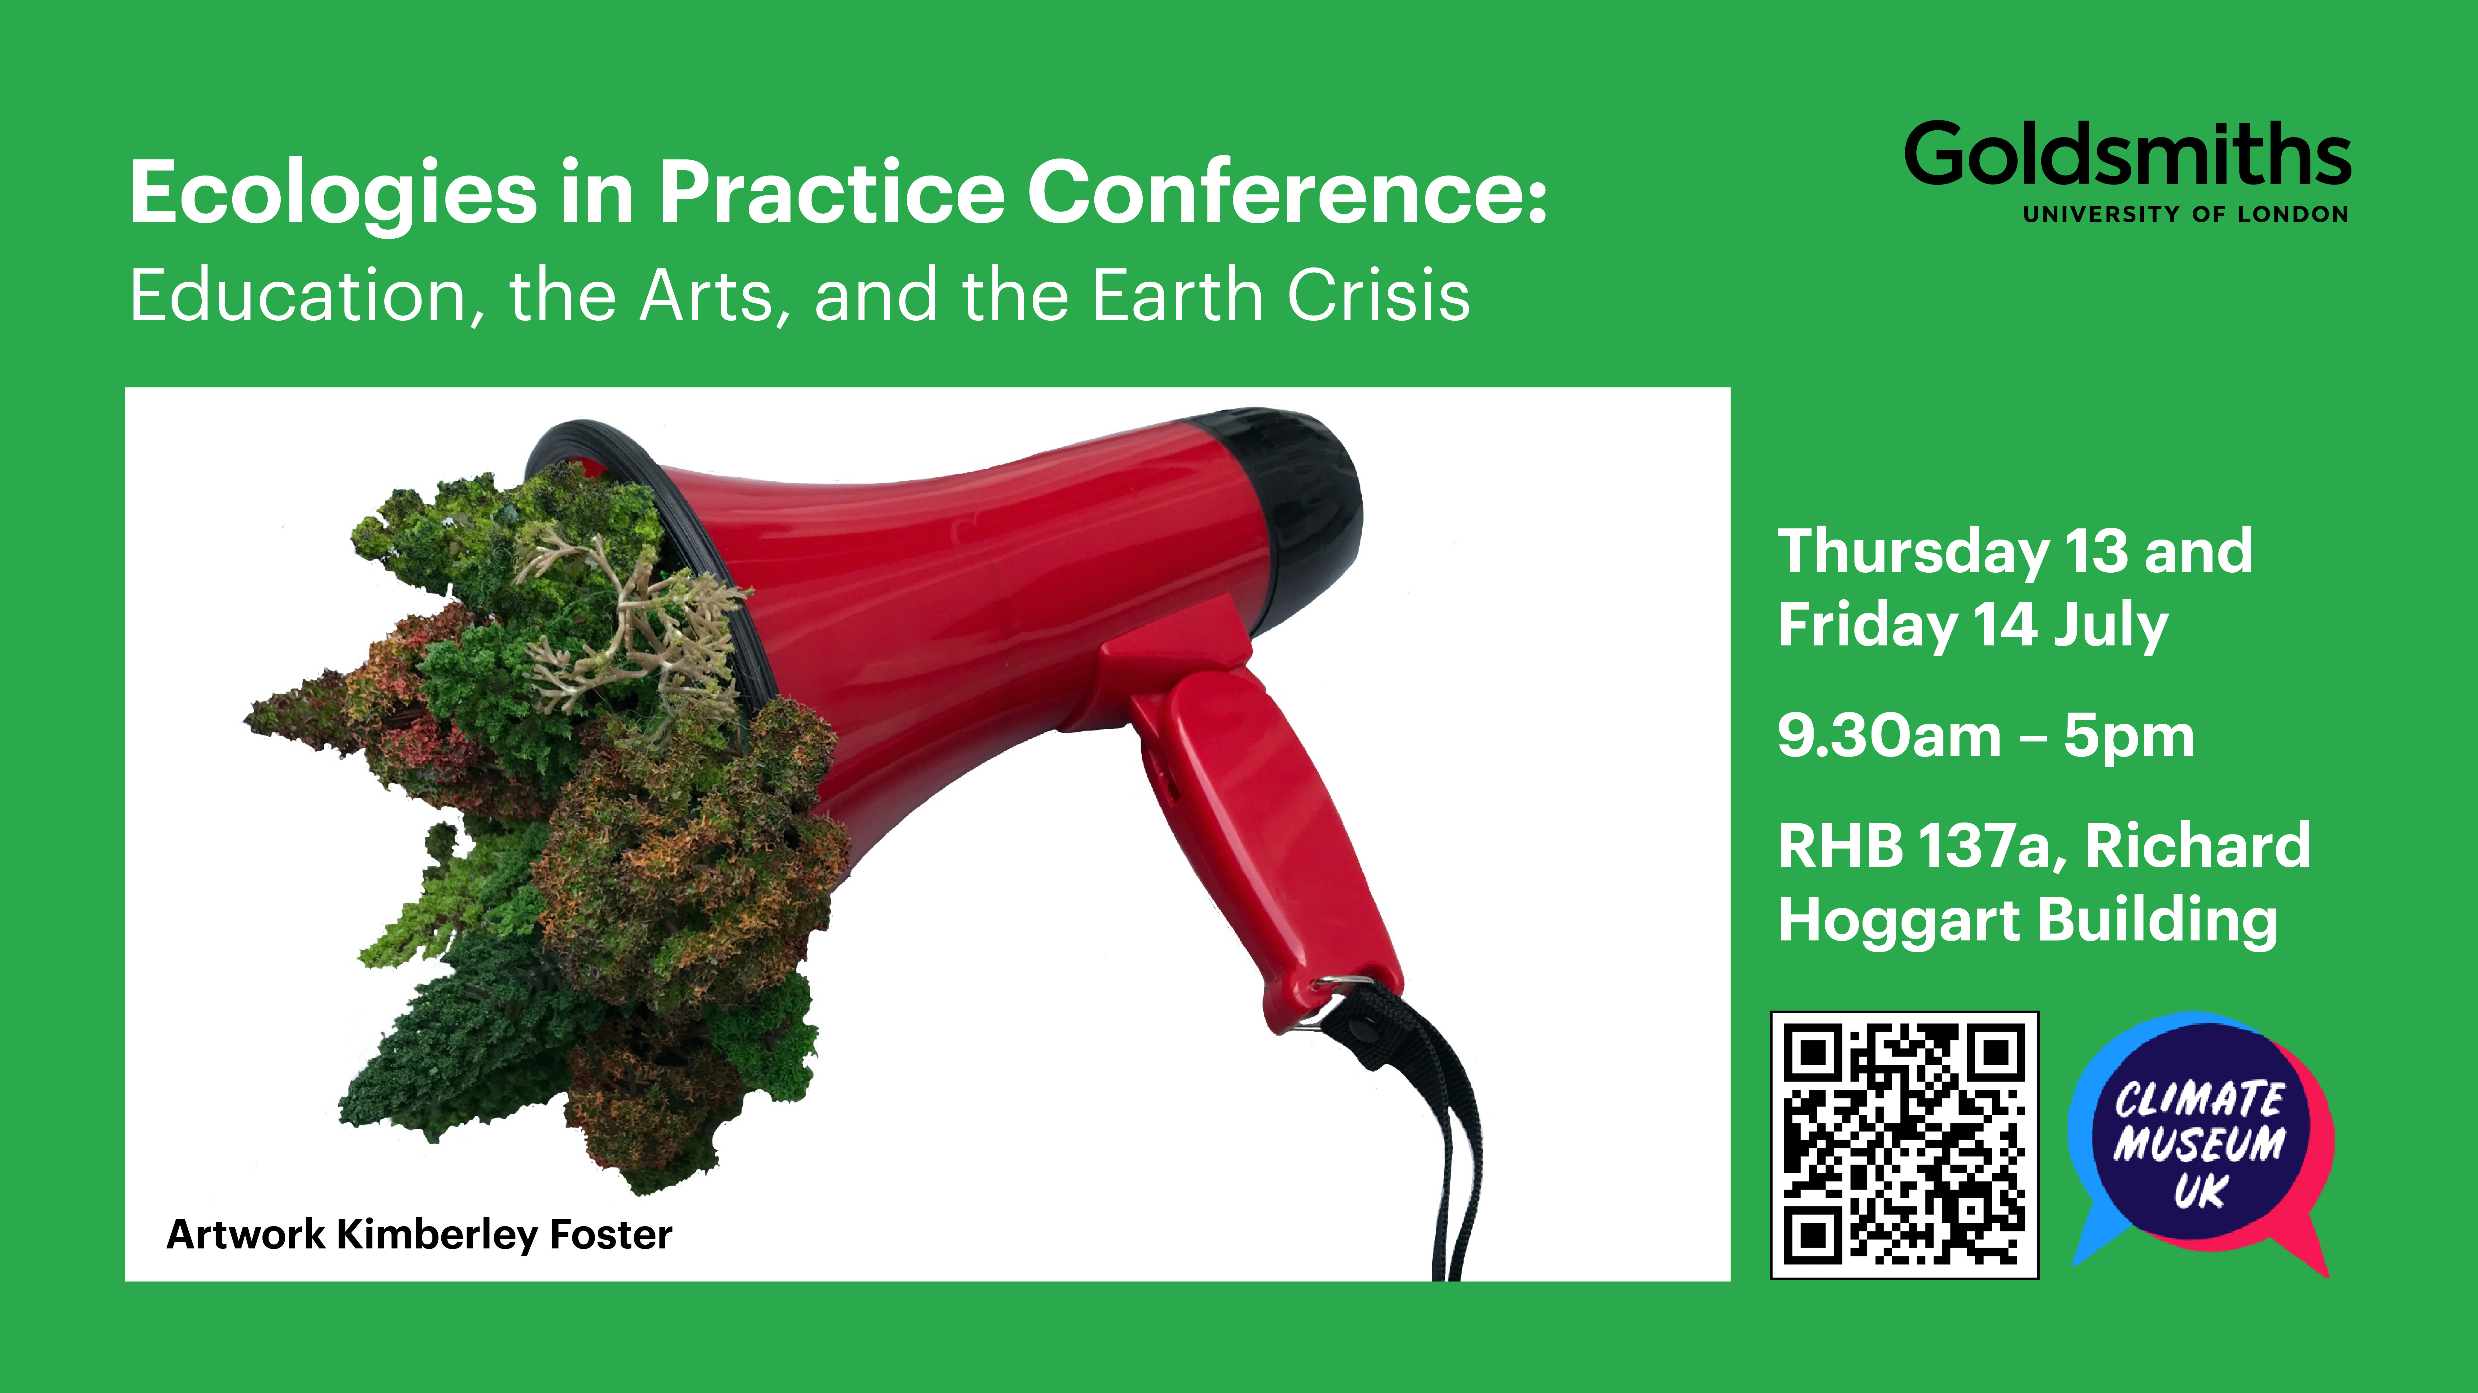
Intentions to..
Develop ongoing cultural ecologies in practice, bringing together partner organisations with different audiences, and practitioners working with different artforms.

Slide 9
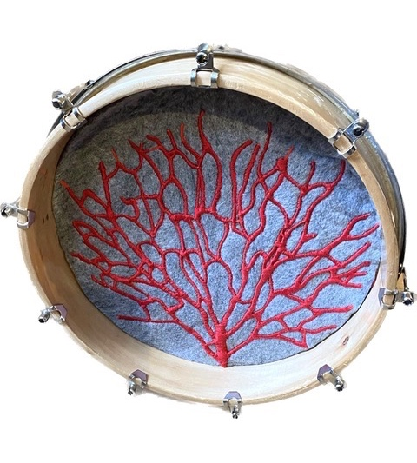
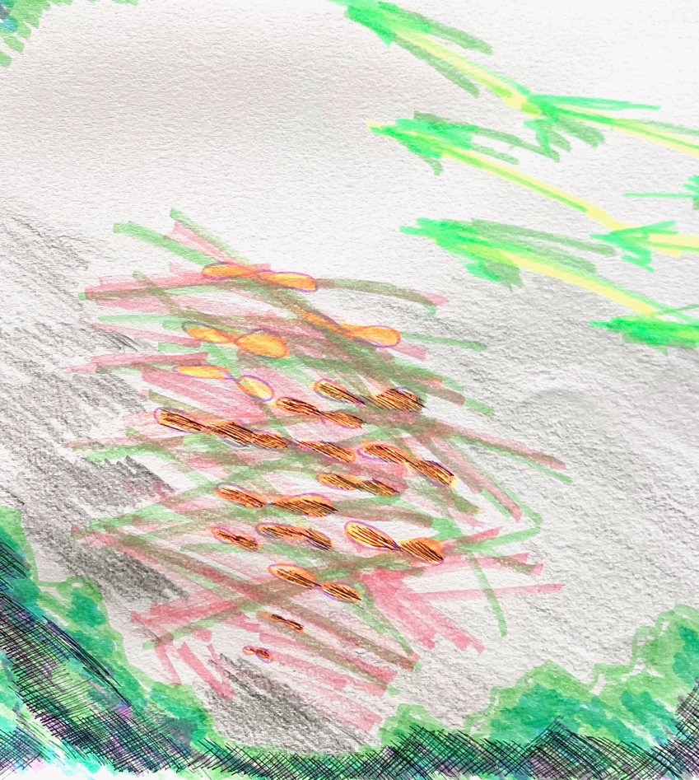
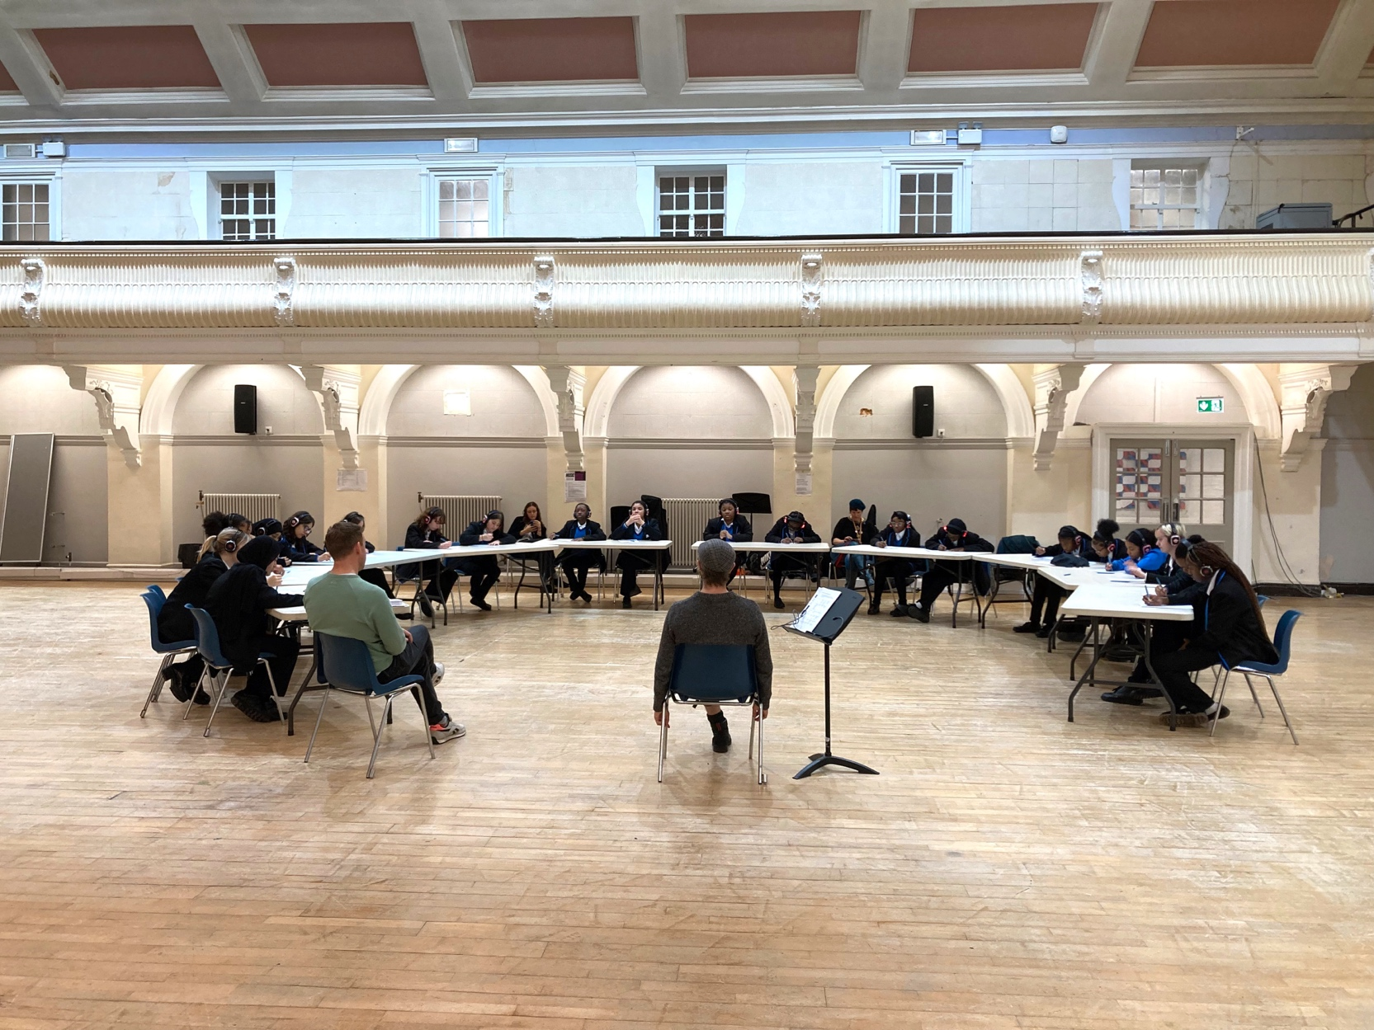
Research design:- methods, approaches, practice researchers and participants
3 workshops
3 arts methods
3 pairs of practice researchers
5 London schools – students aged 14-18
Undergraduate students
Mixed qualitative and practice research with focus groups and surveys
Researcher reflections

Slide 10
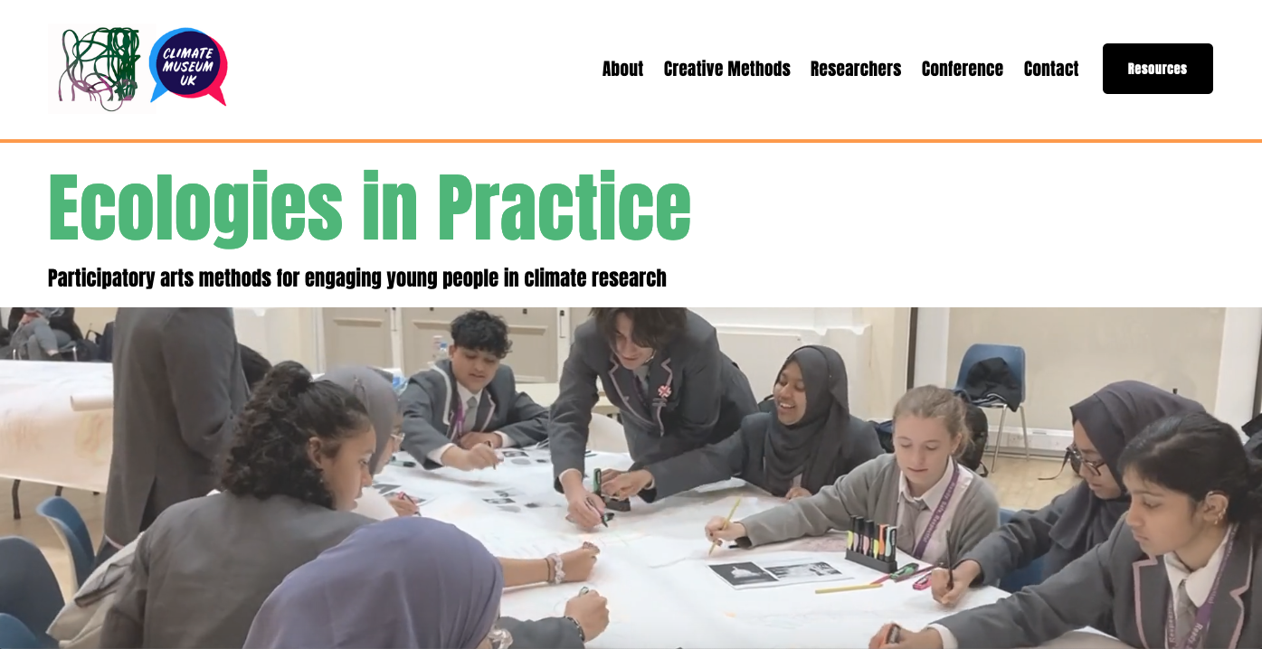
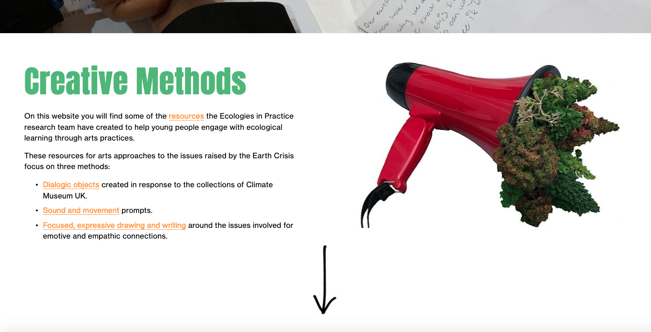
Research design: methods, approaches, practice researchers and participants
The CAL/CMUK Ecologies in Practice Website documents how our methods were explored with young people, and the adaptations of practice research during and between the workshops.
https://www.ecoartslearning.net/

Slide 11
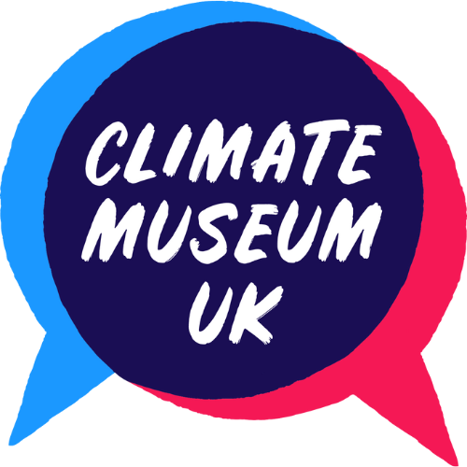
Dialogic play with objects: engaging young people with the Earth crisis
Bridget McKenzie, Climate Museum UK
http://bridgetmckenzie.uk/

Slide 12
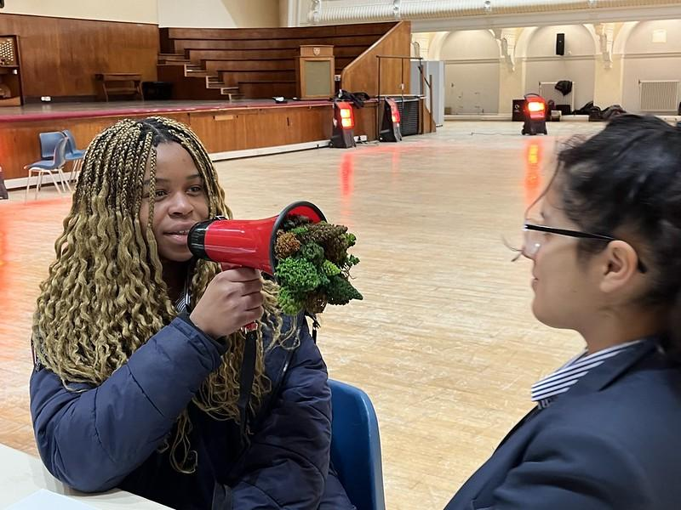
What I’ll talk about
Climate Museum UK as an experiment
Research on engaging young people with the Earth crisis
Dialogic play with objects - how does it enable voice?

Slide 13
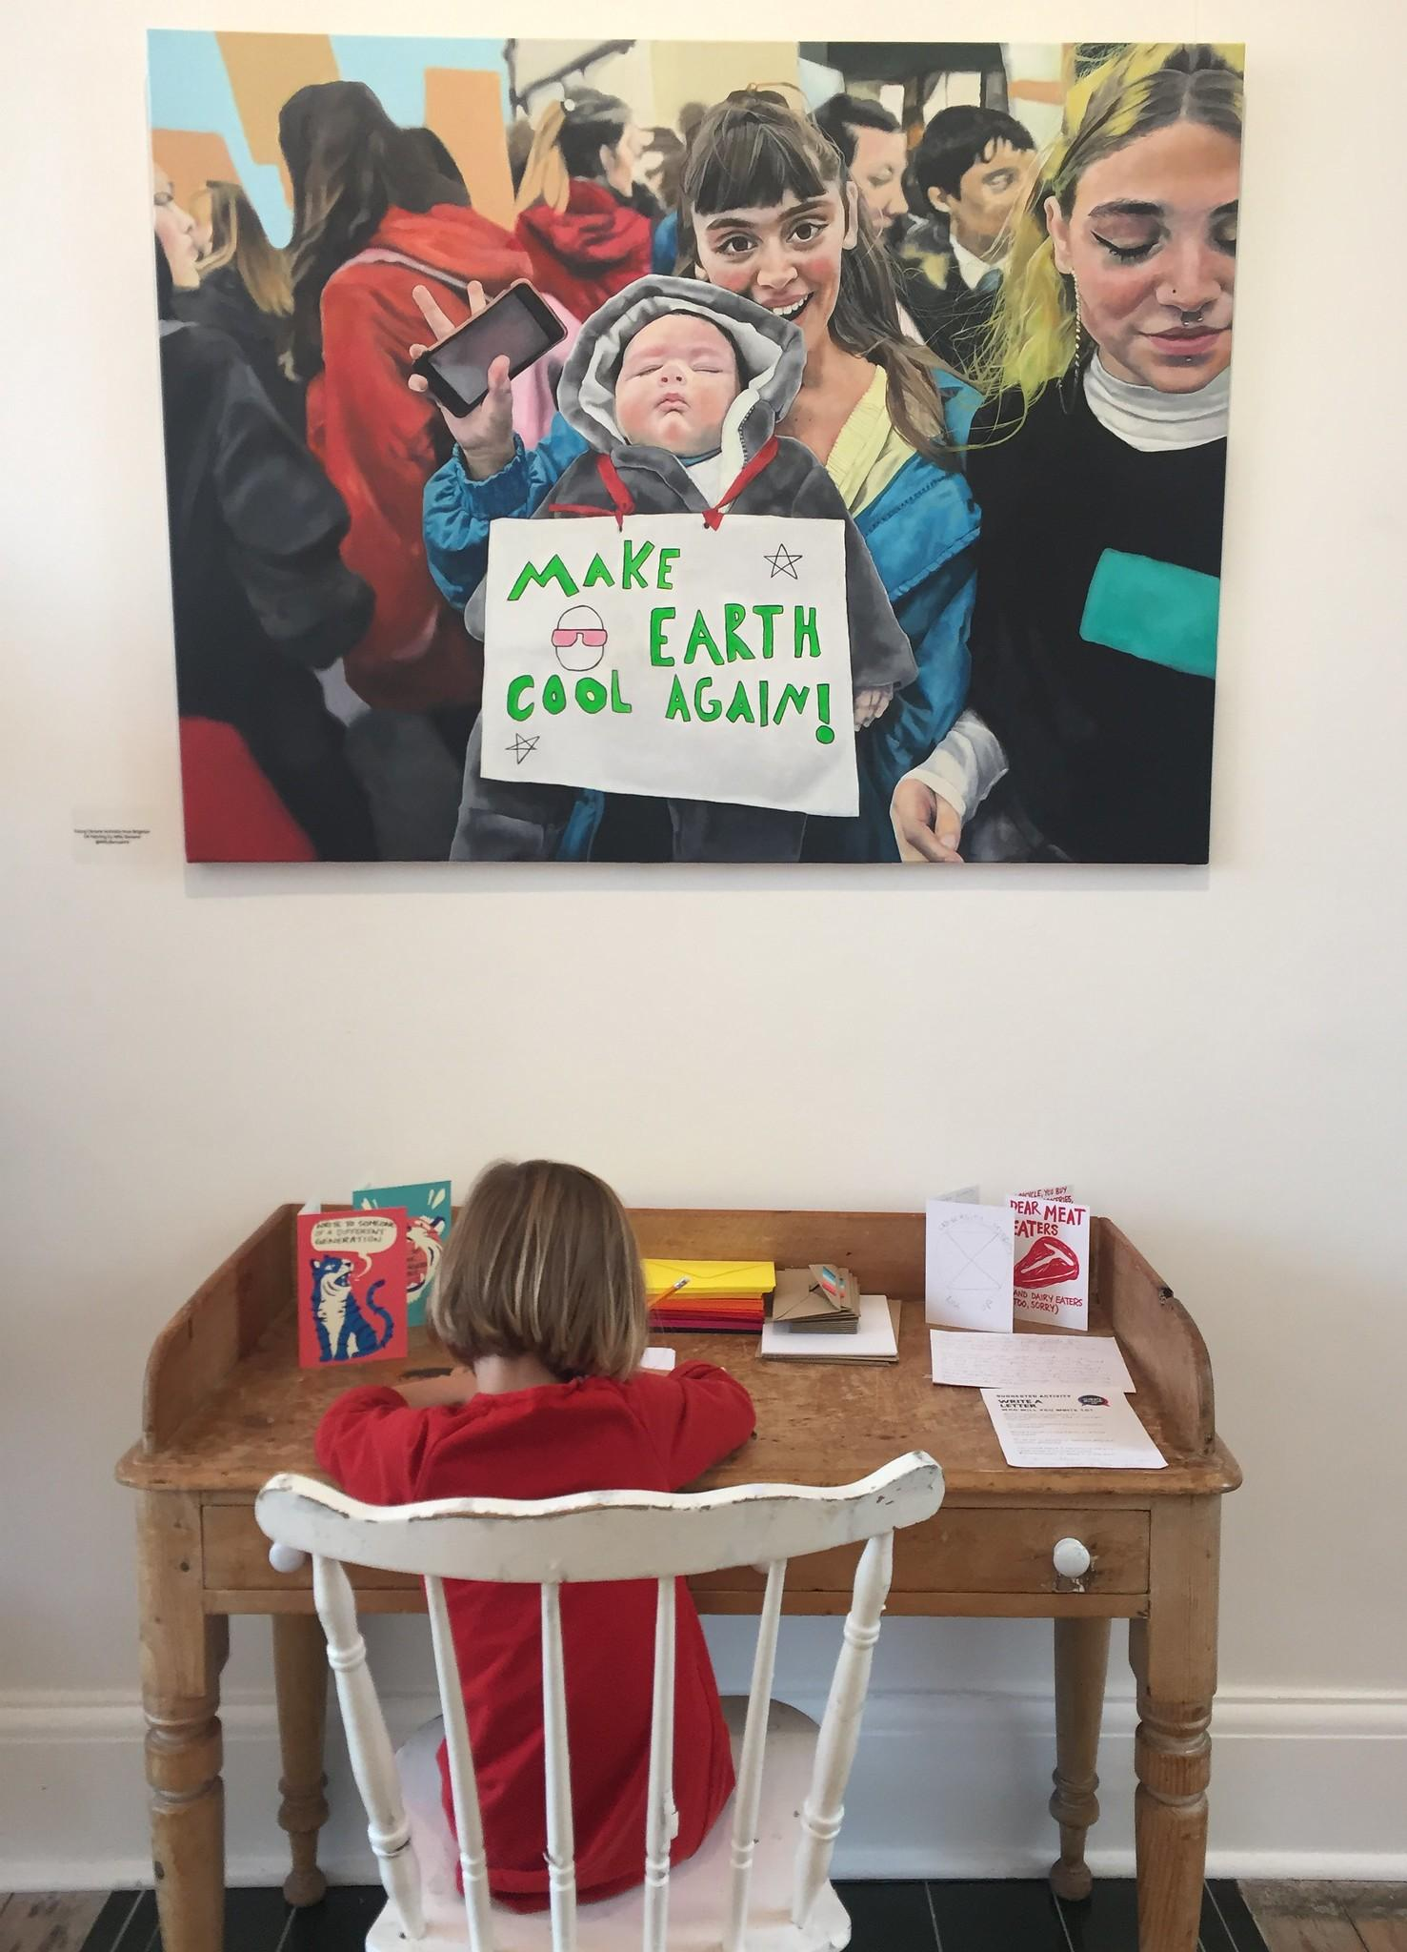
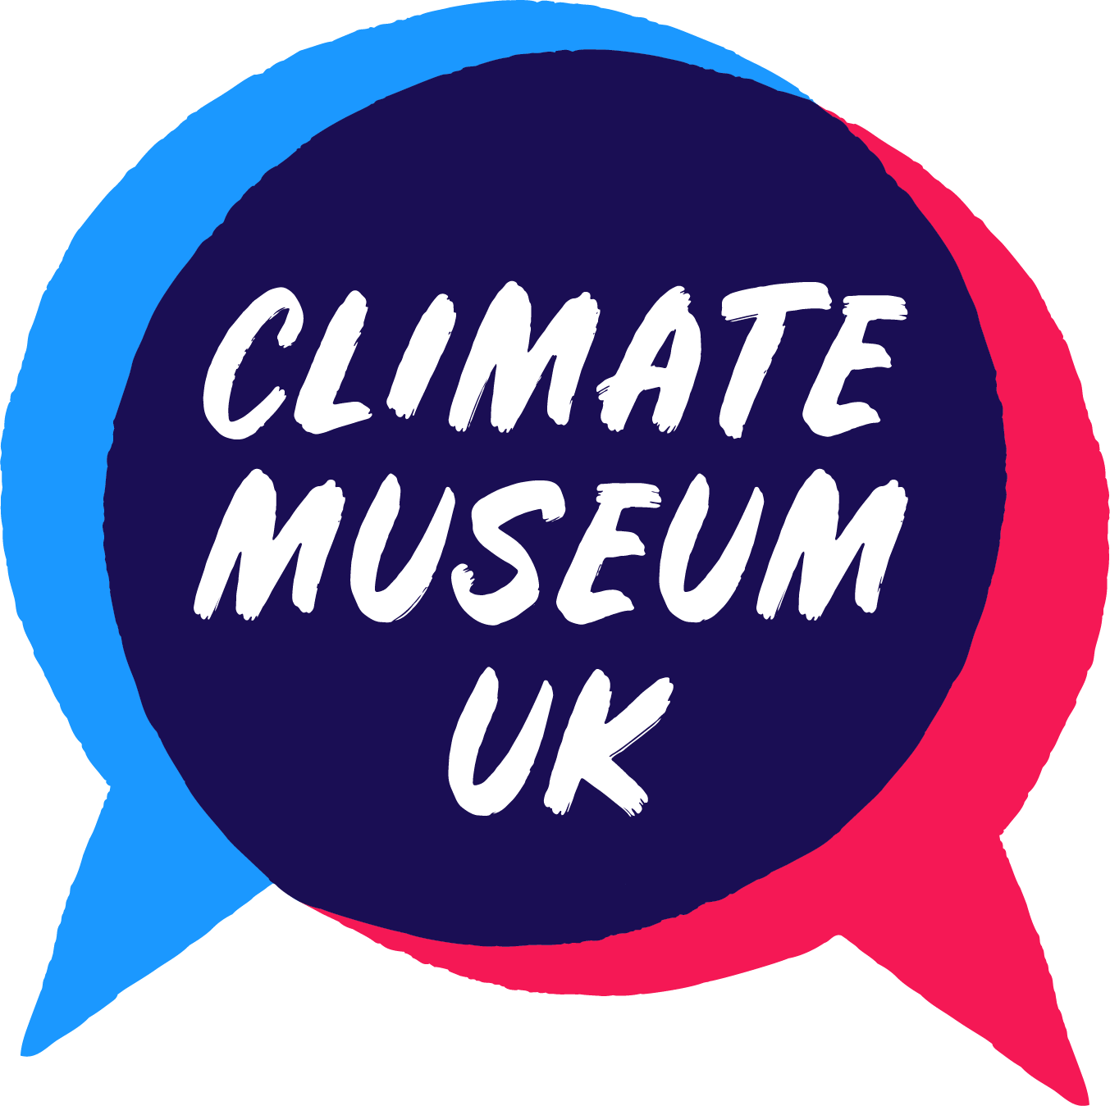
Climate Museum UK
An experimental museum curating and gathering responses to the Earth crisis.
A team of creative people distributed across the UK, we make and gather art, objects, ideas, games and books.
We use or generate these in activations to help people to play, make, think and talk about the crisis and to open their imaginations to possible futures.
climatemuseumuk.org
Notes:
CMUK - one slide not three

Slide 14
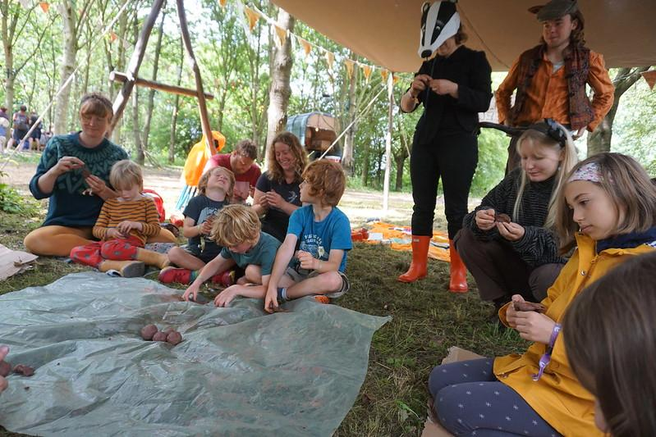
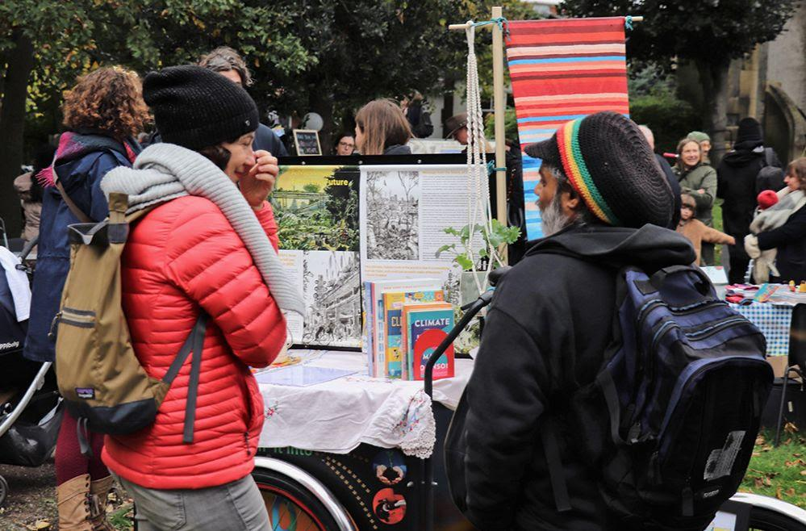
An experimental museum - we theorise that effective activations are dialogic conversations with creative stimuli and objects
Notes:
A historical, situated and material-focused take on the Earth crisis. The importance of externalising emotions about the Earth crisis, situating your own experience in relation to others, and finding solutions for the future amidst learning about the past.

Slide 15
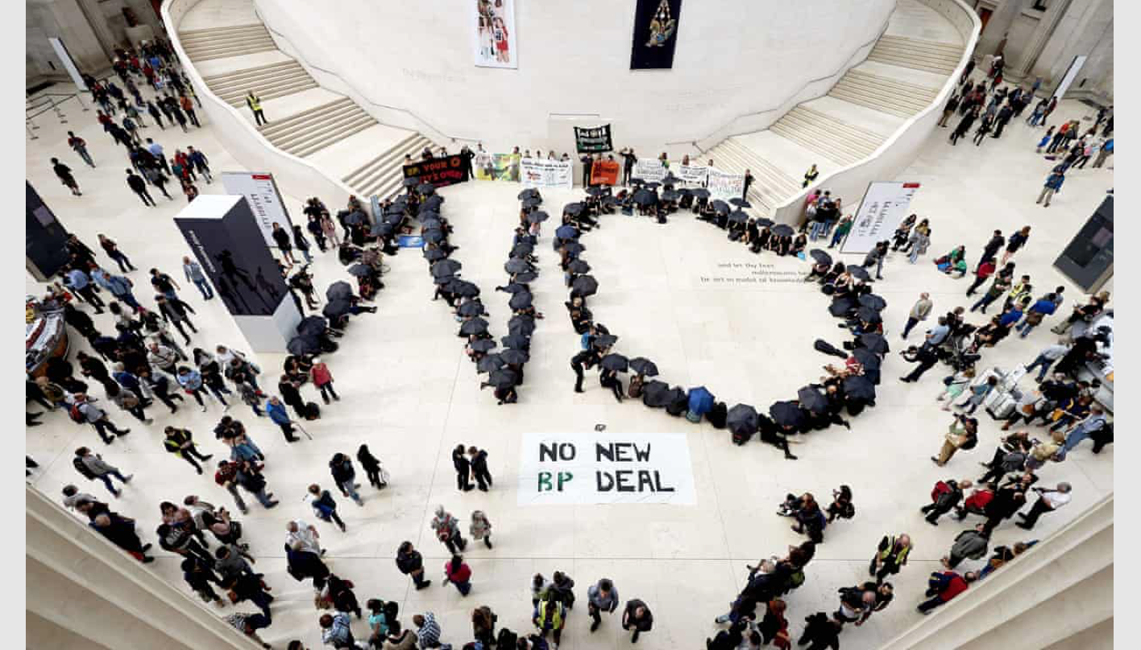
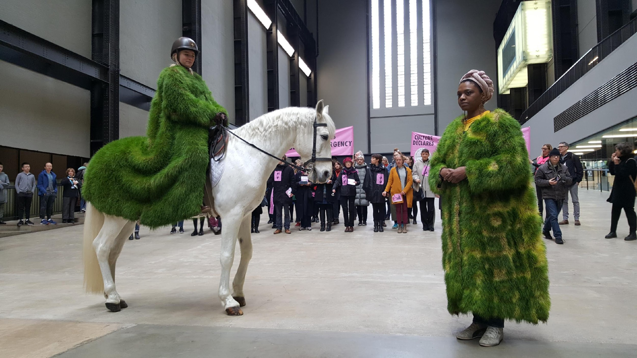
Experimental cultural practice:
Imagination activism
Declaration
Resistance
Clarity of Voice
Spectacle
Notes:
Emergency – spectacle – role of artists

Slide 16
Climate Outreach research on YP & climate, 2022
Affected, like adults, by discourses that minimise the crisis
Lack understanding of climate justice - or global reparative thinking
BUT, MORE THAN ADULTS
Reject narrative of climate as future problem for young to sort out.
Reject complacency of adults with means to make a difference.
Expect to be told truths. Express truths in direct & blunt ways.
So, how do they respond to arts about the crisis?

Slide 17
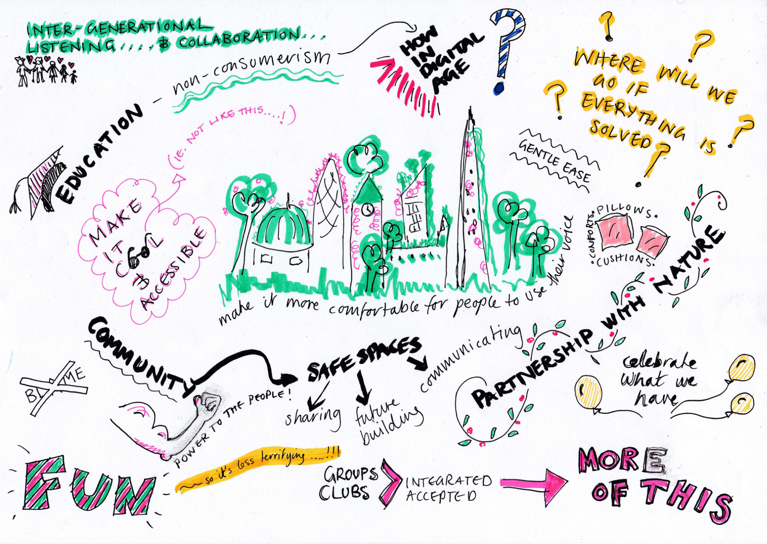
CMUK research for A New Direction Listening Project
Don’t bracket out the Earth crisis: carefully design ways to explore it
Don’t pigeonhole or burden young people as eco-warriors
Can’t assume voice is natural: Knowing more about the Earth crisis brings confidence to speak
Trauma-sensitive adult support: meaningful youth voice requires profound awareness of needs
https://anewdirection.org.uk/research/listening-projects
Graphic responses in report - Hannah White, Stephen Shiell, Artur Vidal
Notes:
[A lot of text here, just notes to remind me, not to speak through…]
What kinds of arts learning provision are radical enough to do justice to young people in the context of the Earth crisis and their limited expectations of safe futures? How do we design arts learning experiences that are collapse-aware without shutting down creative potential? Is there an effective balance between informing learners about this complex and troubling situation and enabling generative enquiry and expressive art, while being aware of very different needs of age cohorts and individuals?
Don’t bracket out the Earth crisis
There were strong calls for the Earth crisis to be placed front and centre in the curriculum, cultural practices and the wider media and politics. They want the crisis to be taken seriously, and treated holistically. They want its systemic root causes to be understood as the same root causes of the major ills affecting society, including the pandemic. The existential threat to future generations should drive all decision-making, and so young people should be involved in genuine ways and empowered to contribute to system change to sustain life on the planet. This means helping them to develop capacities to be adaptive system changers, by supporting generative knowledge through engaging with real situations and problems.
Carefully design opportunities to explore it
Although the Earth crisis needs to be more acknowledged, it needs to be treated in ways that feel comfortable and playful, and this points to the role of cultural organisations. The young people asked for friendly, fun and inclusive cultural spaces where sustainable behaviours and ideas were integrated and normalised. All want to see more intergenerational opportunities for shared learning, while young people also feel most comfortable with peers and near-peers.
While cultural organisations can play a key role here, schools and colleges are where CYP spend most time. There were calls for curriculum reform to put ecological capacities, Earth sciences and futures literacy across all subjects, including the Arts.
Because everyone shared the value of culture and creative practice for widening and enhancing learning, this wasn’t a major subject of debate. Barriers need to be unlocked for more cultural provision addressing the Earth crisis and nature connection, putting it more centrally in cultural policies and funders’ priorities.
Don’t pigeonhole or burden young people
Young people do not have homogenous feelings, thoughts and behaviours about the Earth crisis. Their responses vary according to age, context and capacities. Young climate activists feel very different from peers who aren’t so aware, and don’t like their generation to be pigeonholed as ‘climate warriors’, or burdened with the role of saving the planet.
Individualism or collectivism
Some felt that culture and education need to shift from individualism (e.g. ‘getting on in life’) and that more collectivism would help solve environmental problems. However, creativity has particular power in engaging people at individual and emotional level. Digital culture offers routes to making sustainable mindsets more appealing and motivating. Culture & creative practice can enable individual expression and identity formation, and help young people find alternatives to consumerist addictions and towards planet-kind vocations. Culture is about both individuals and groups, connecting together: “Culture is important as it focuses on how we have a 'group' or cultural responsibility to act to address this crisis, this sense of unity and collective action can be useful for young people in making them feel united, rather than alone.”
Knowledge brings confidence to speak
If YP are always assumed to be too fragile to cope, this can stop adults addressing the truth and connecting them to hopeful, practical resources to make change.
YP asked for more opportunities to learn and develop skills for activism and greener livelihoods, to make their calls to action more credible and consequential. They want adults to imagine the future more as they do, as a world of profound uncertainty and possibility. They need this anticipation of ecological crisis to be integrated into how education, careers and creative practices are conceived.
Trauma-sensitive teaching and parenting
Cultural workers and Educators & parents are struggling with the enormity of the challenge, with a strong sense of injustice and inadequacy to support and educate CYP in this context. Parents are more aware of the limitations of the education system as the pandemic has thrown them into a closer relationship with it, and, with many teachers, are asking for CYP’s wellbeing to be paramount. The adults we spoke to feel almost as voiceless as young people do, because they need more skills and freedoms to address the Earth crisis and the traumas arising from it. How do they bridge the gap between supporting radical change and their own needs to maintain livelihoods and hold power?
Meaningful youth voice requires more profound awareness of needs
Cultural programmes and creative education can offer more freedom and platform for youth voice than other areas (e.g. science or sport). If the framing and recruitment of youth panels is based on limited assumptions of young people’s interests such as digital technology, and on limited remits such as growing youth audiences for culture, opportunities for catalysing change and tackling injustice will be limited too.
Youth voice can be diminished through poorly designed cultural practice that treats Earth crisis issues superficially, without clarity or without commitment.
Sustainable cultural learning is intersectional and ecological
All groups wanted best practice to be promoted and funded, which meets human and environmental needs in intersectional and ecocentric ways. If youth leadership on this is supported, it is likely to arise from motivations for justice, and an awareness of how racism, inequality and environmental harm intersect.
A common theme across all groups was nature connection and green place-shaping as a positive route to imagining and building a thrivable future. Culture & creative practice has a key role to play in “the framing of that imagination through our relationship with nature. The ecological stories contained in any place is something that culture can richly pursue on a local scale and a grander scale.”

Slide 18
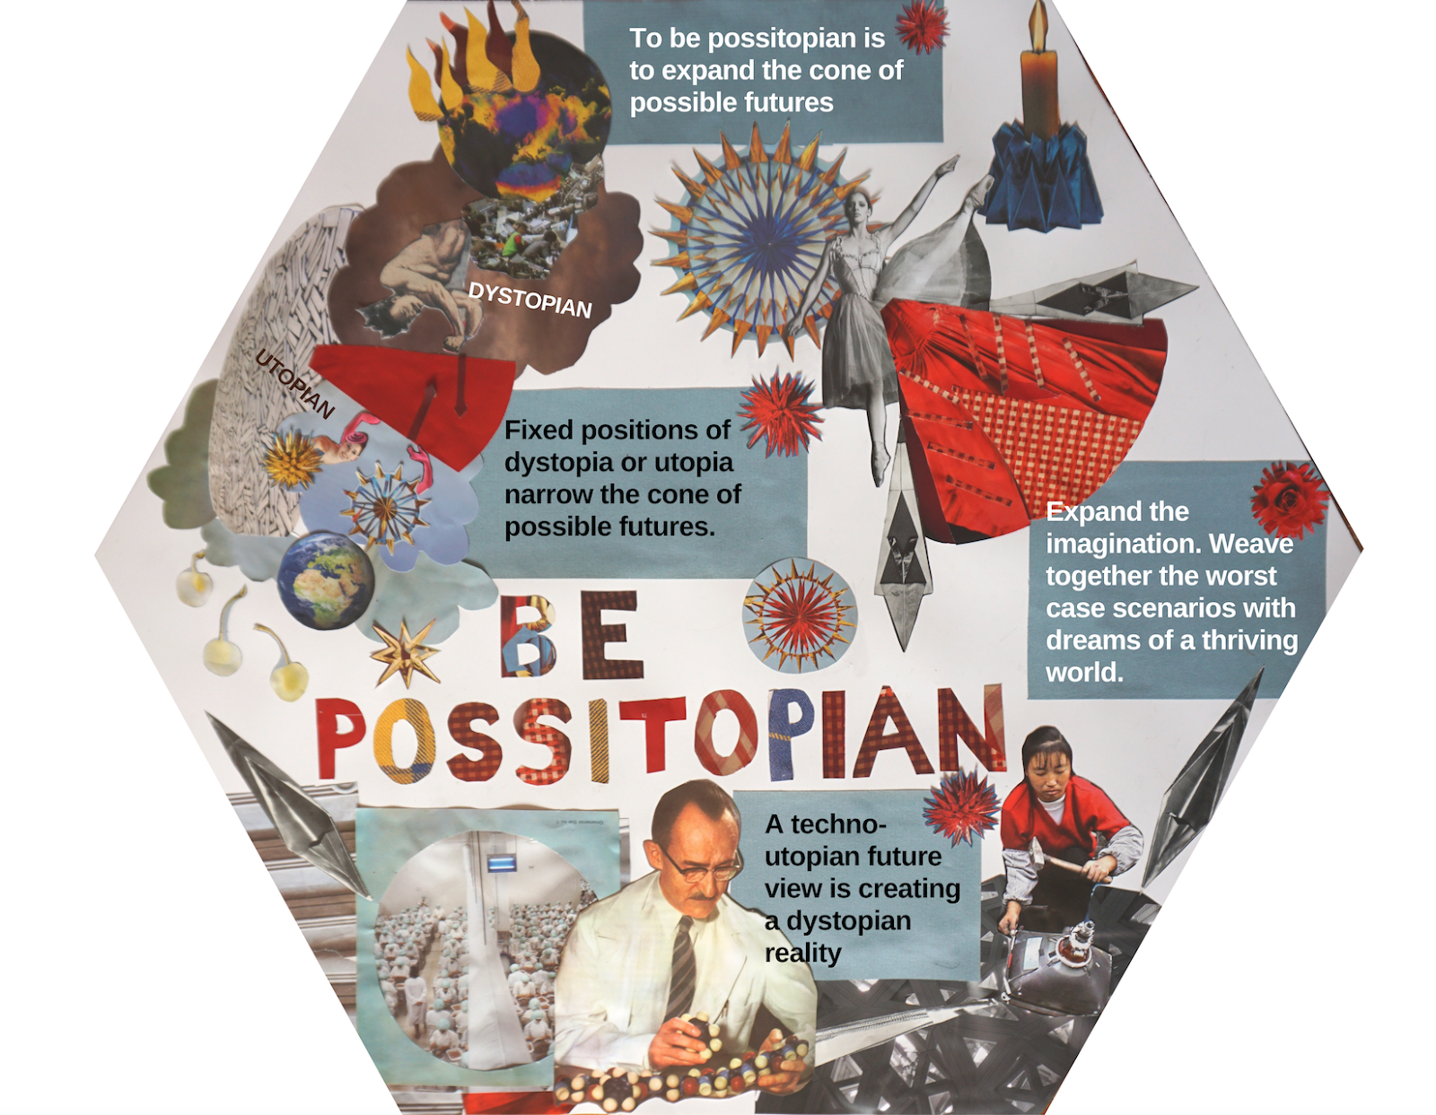
Being Possitopian as an imagination practice
Unique principle of CMUK: An approach to future thinking that expands the possible future, drawing on physical realities + imagination.
Notes:
Enabling agency & mental wellbeing by facing emotion about the challenges, and exploring what we can do.

Slide 19
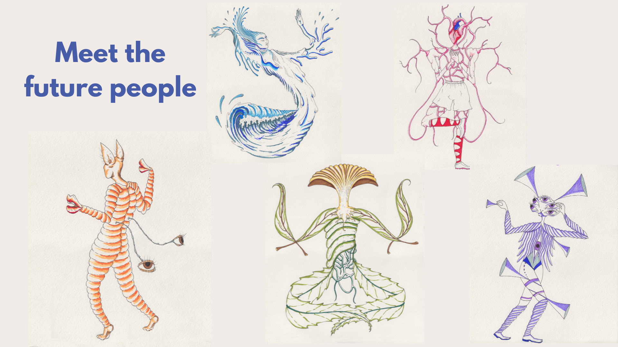
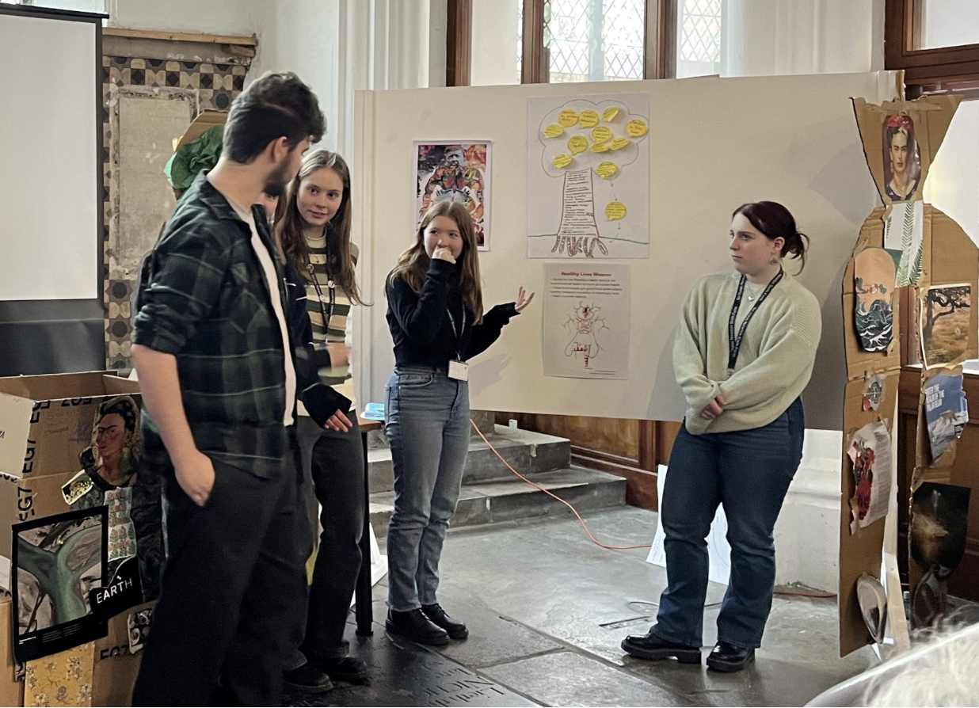
https://imaginefutures.net/ Supported by Festival Bridge
CMUK Imagine Futures: trialling arts-led approaches for young people to imagine futures

Slide 20
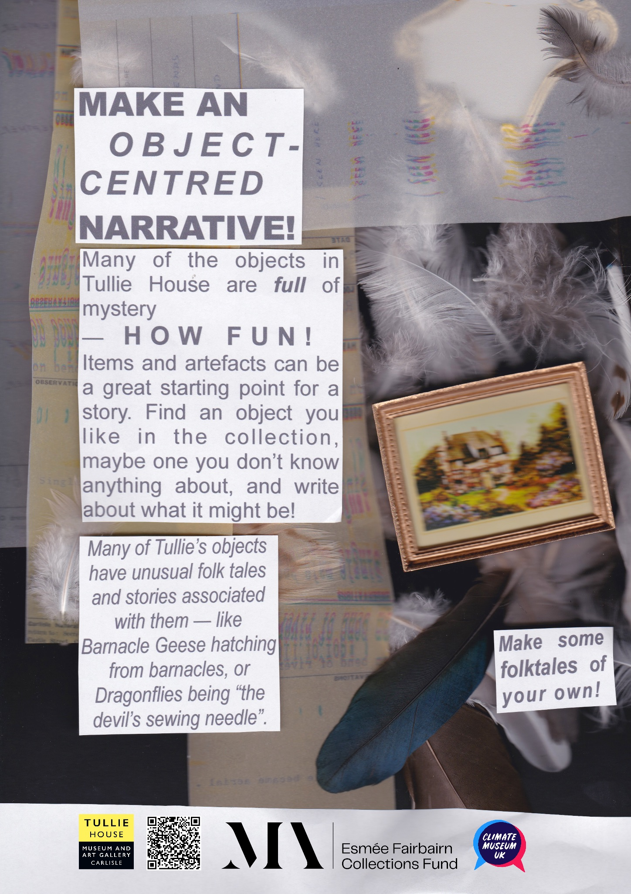
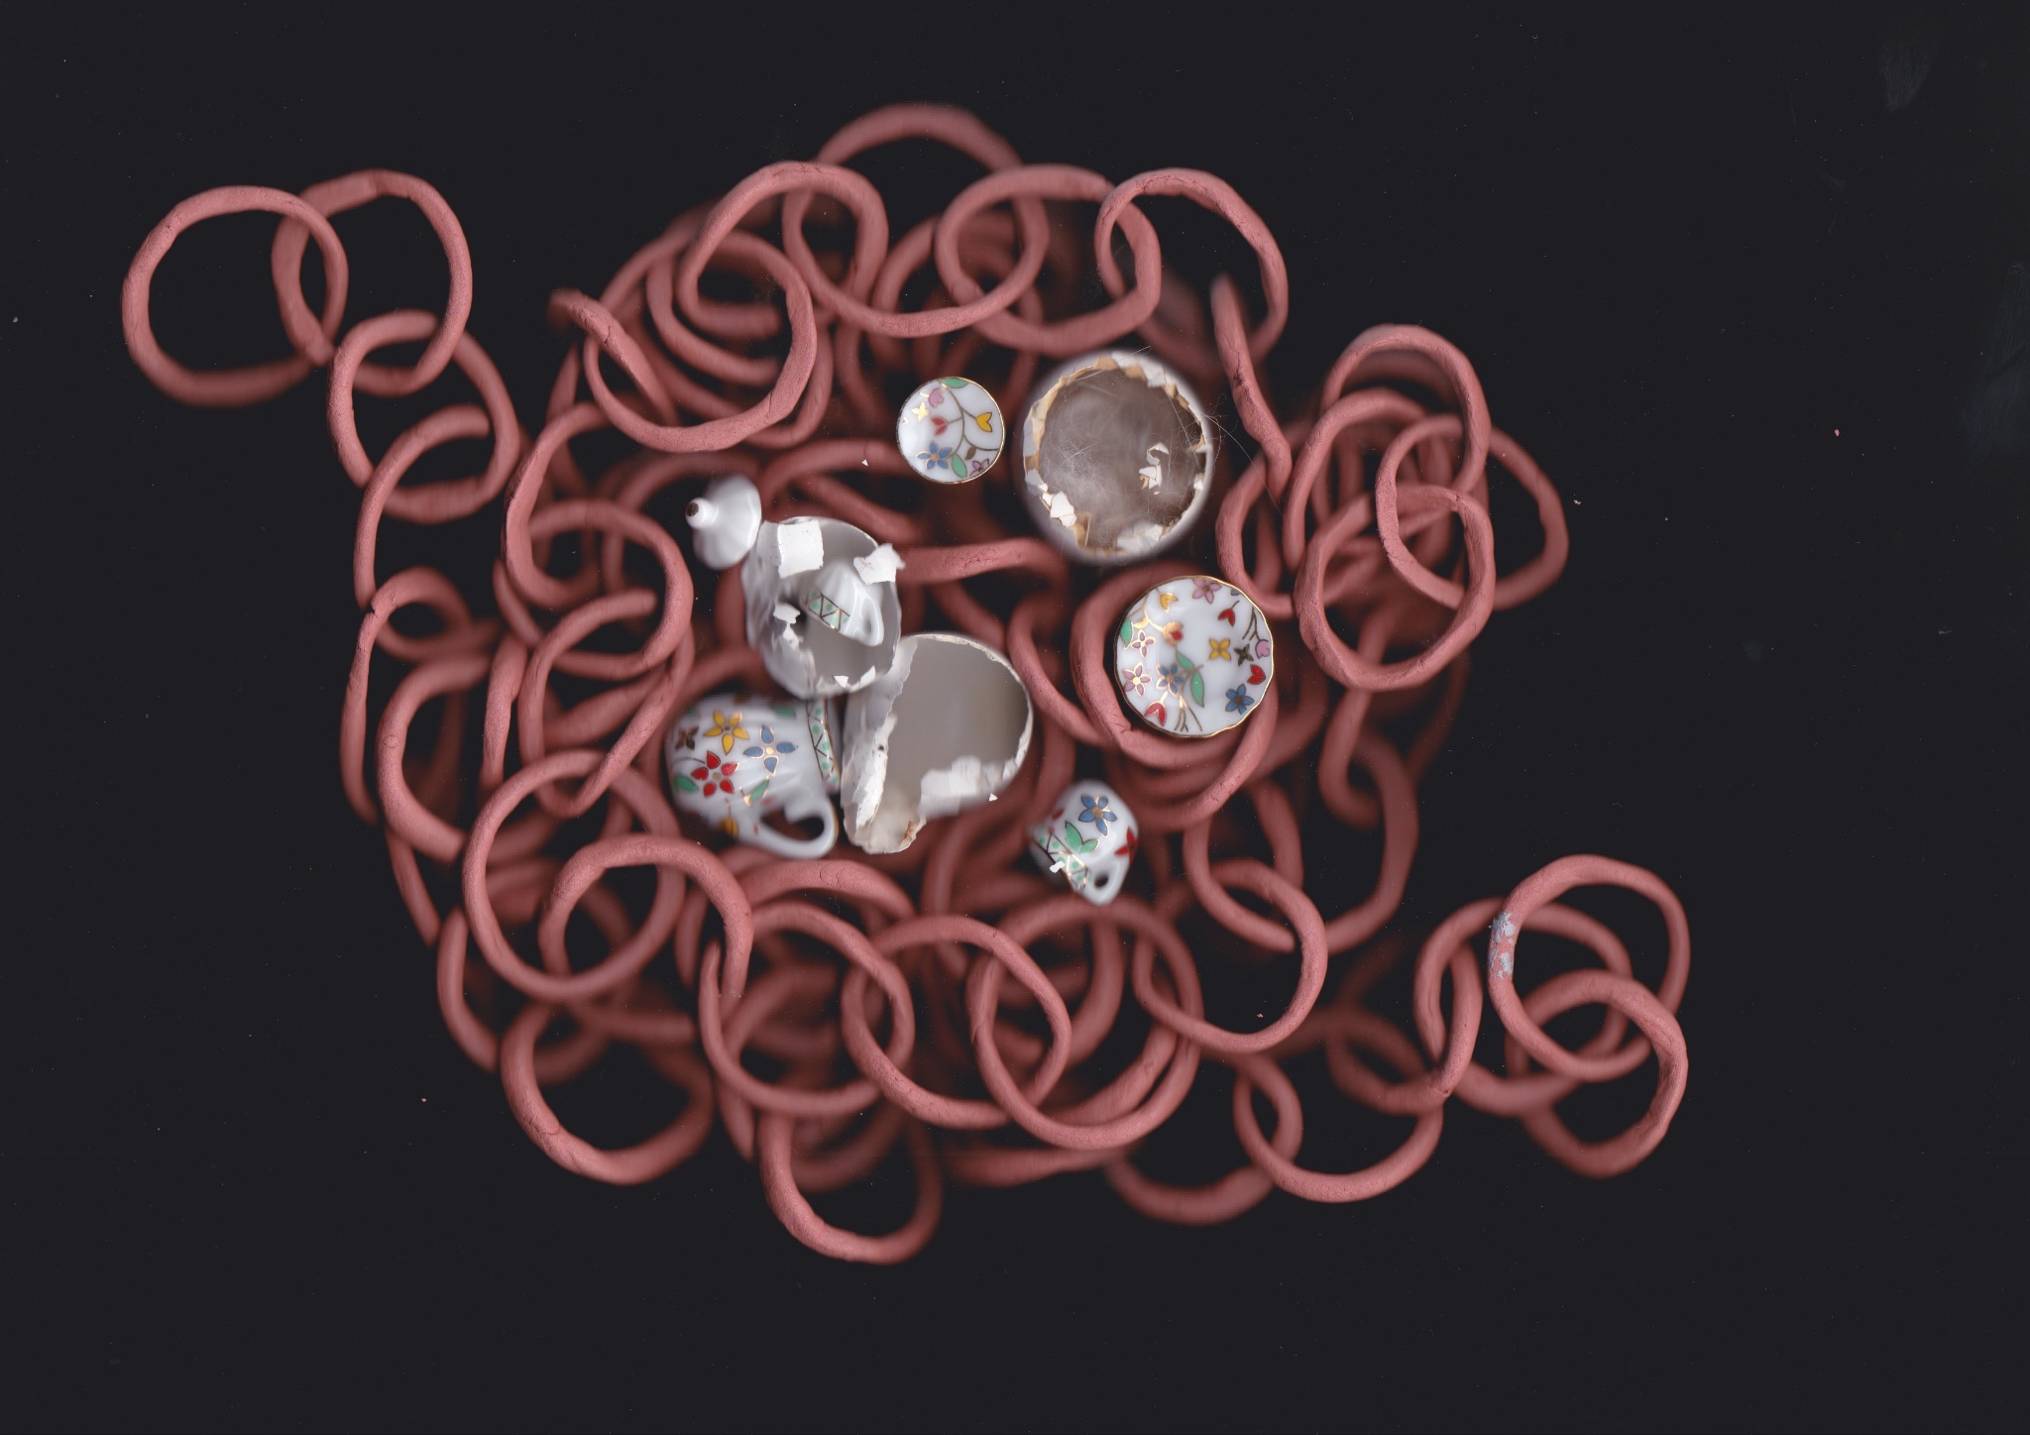
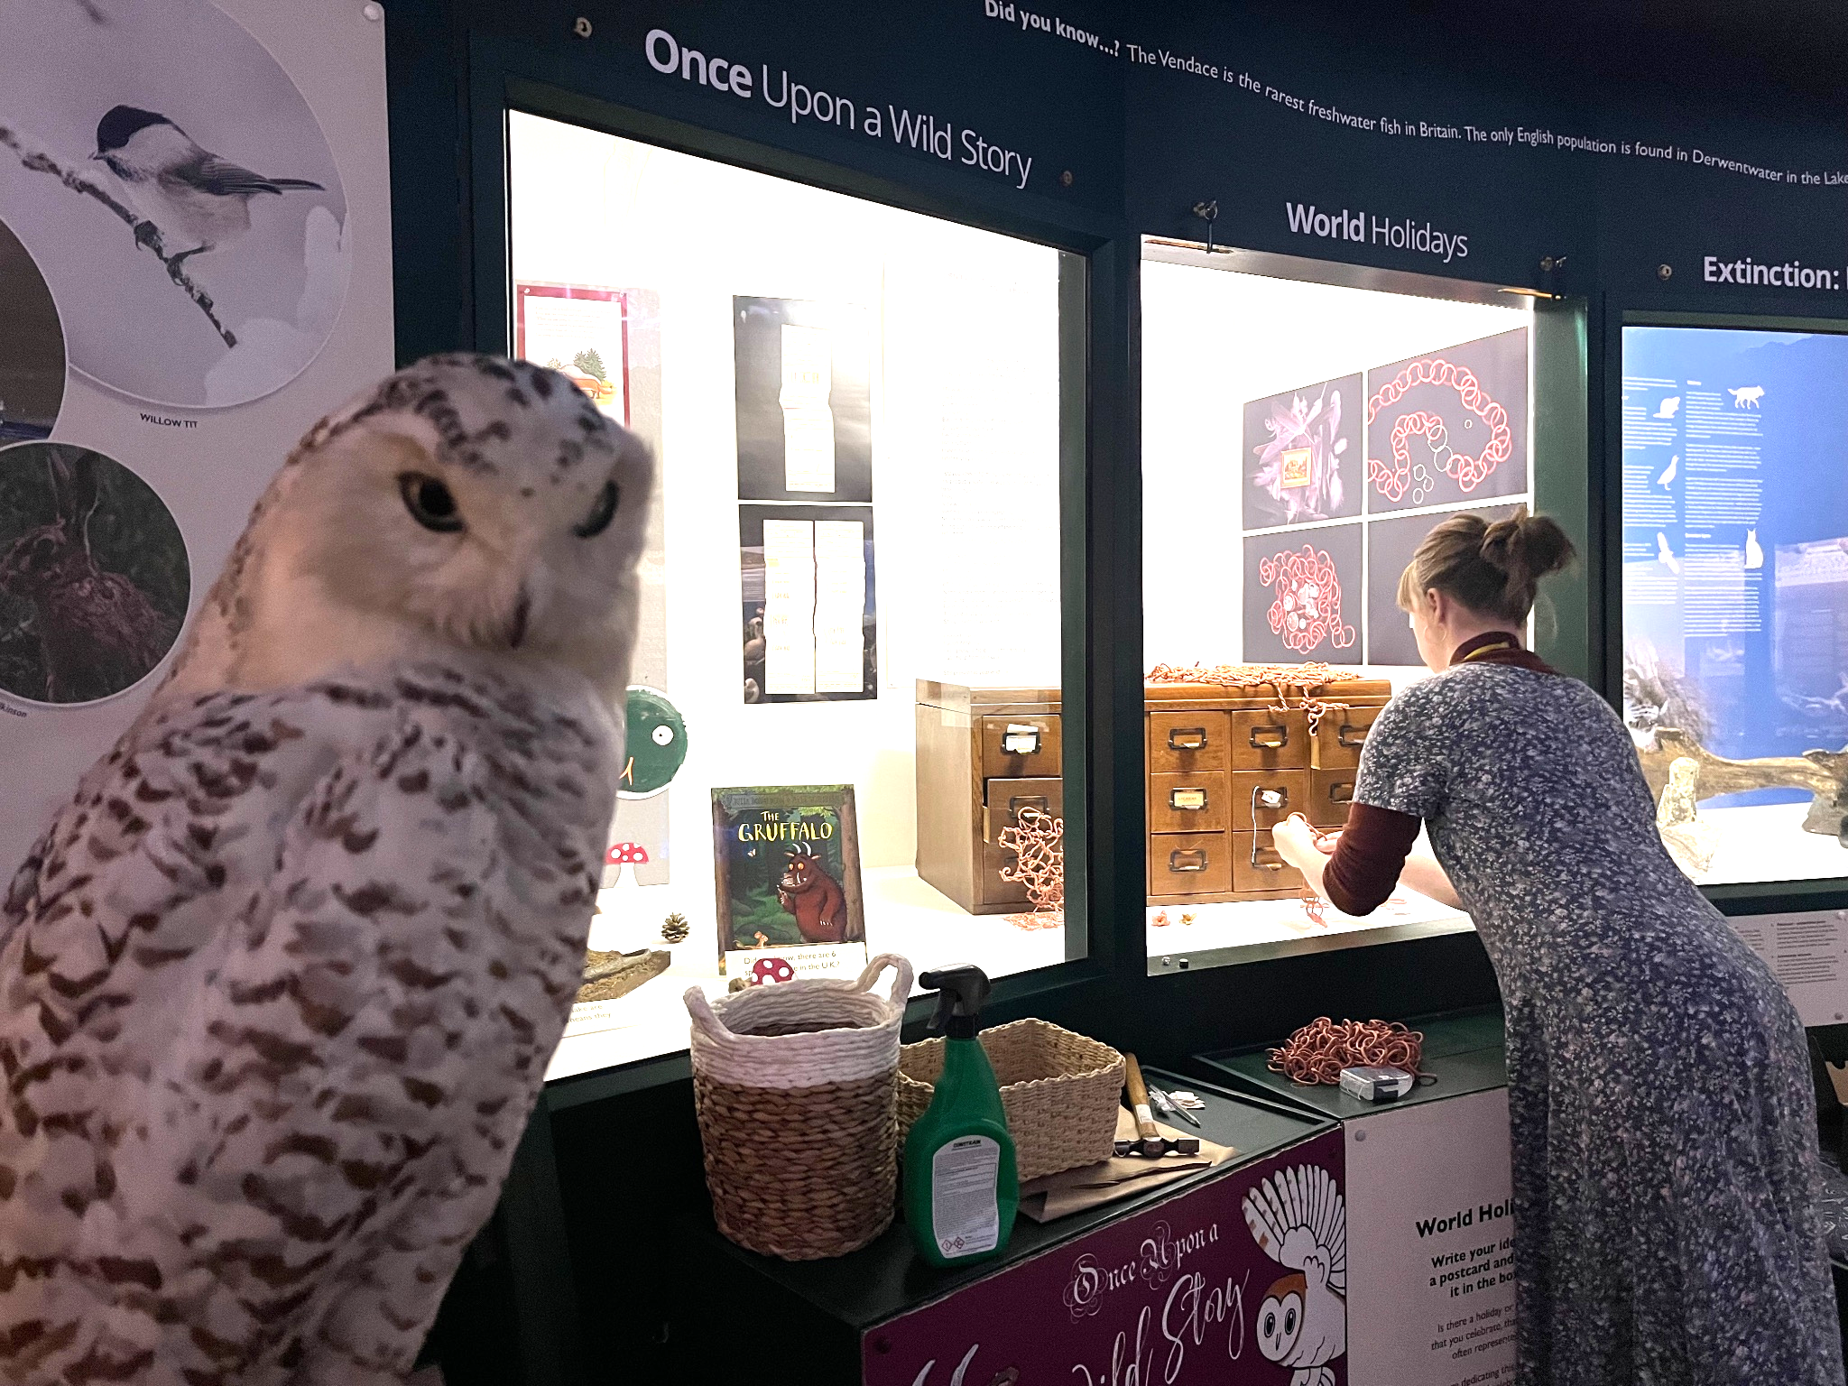
‘Once Upon a Planet’: Tullie House Museum
Young artist in residence - Megan Bowyer - a CMUK associate
Played with objects & their meanings
Notes:
Combinatory poetics
An Eco Lens on Things
Challenged visitors to create their own object narratives

Slide 21
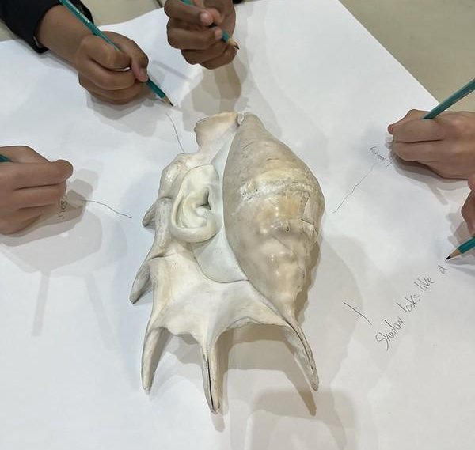
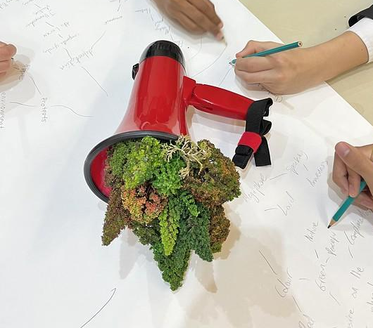
I worked with Kimberley
Foster, Norwich artist
Arts-led methodologies for engaging young people in the Earth crisis. Goldsmiths.

Slide 22
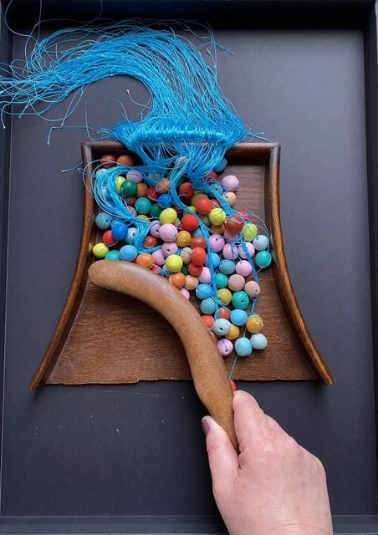
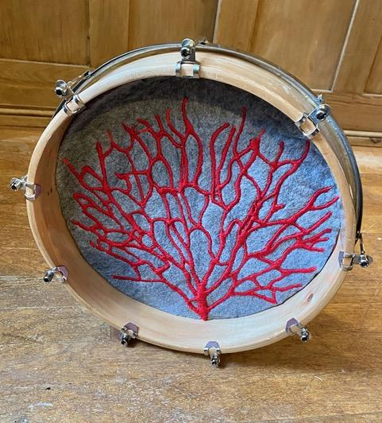

Slide 23
Difficulties and Discoveries in practice research
Sound and Movement
Free drawing and Writing
Exploring with Objects

Slide 24
Questions emerging
How to adapt to the pressured time spaces available to students aged 14-18 and undergraduate students?
How to share knowledges and happenings of pedagogy and practice for synergies and consistency?
How to maximise opportunities for inclusive participant voice?
How to develop corresponding bodies of information, without trying to communicate too much?
How to validate the artworks created by young people?
How to combine ethical research, indirect pedagogies and critical pedagogies?

Slide 25
Key findings
More attention on the causes and less on the impacts of the Earth Crisis enables empowered ‘artivism’.
Arts methods that bring in sensory expression in addition to scientific knowledges are much appreciated by young people!
We combined access to innovative new arts experiences with methods that could become accessible takeaways for young people.
Synergies gathering among the three arts methods are cumulative, and participants bring elements on to the next method.
Careful attention to timing, interaction, process, materials and environment for arts experiences is essential – even for experiences that feel spontaneous for young participants.

Slide 26
References
Atkinson, D. 2018, Art, Disobedience and Ethics: The Adventure of Pedagogy. Cham, Switzerland: Palgrave Macmillan.
De la Cadena, M. and Blaser, M. eds. 2018, A World of Many Worlds, Durham and London, Duke University Press.
Ecoartslearning https://www.ecoartslearning.net/
Jagodzinski, j. 2018, Interrogating the Anthropocene: Ecology, Aesthetics, Pedagogy and the Future in Question. Cham, Switzerland: Palgrave Studies in Educational Futures, Palgrave Macmillan
Centre for Arts and Learning https://www.gold.ac.uk/cal/
Climate Museum UK climatemuseumuk.org
Imagine Futures https://imaginefutures.net/
Listening Projects, A New Direction https://anewdirection.org.uk/research/listening-projects
McKenzie, B. http://bridgetmckenzie.uk/

