Slide 1
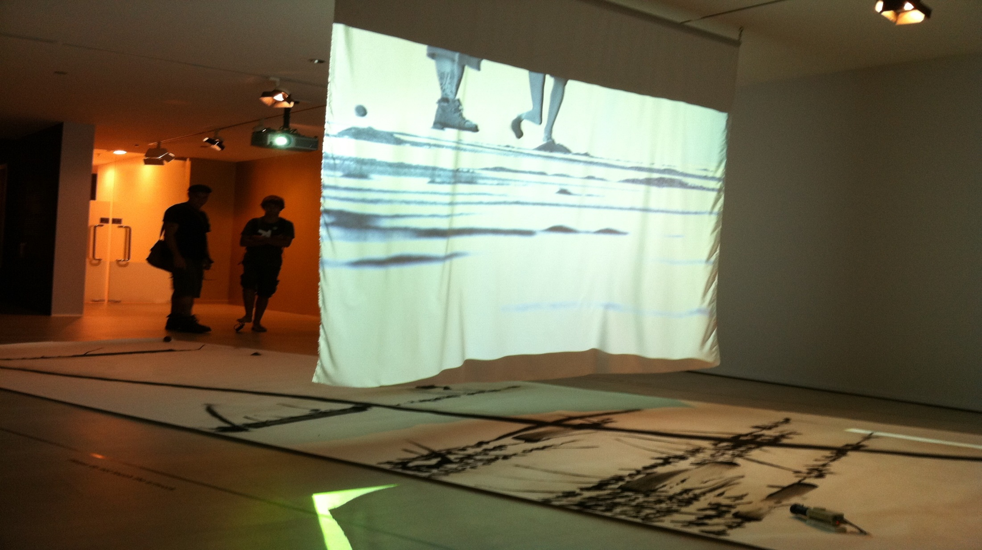
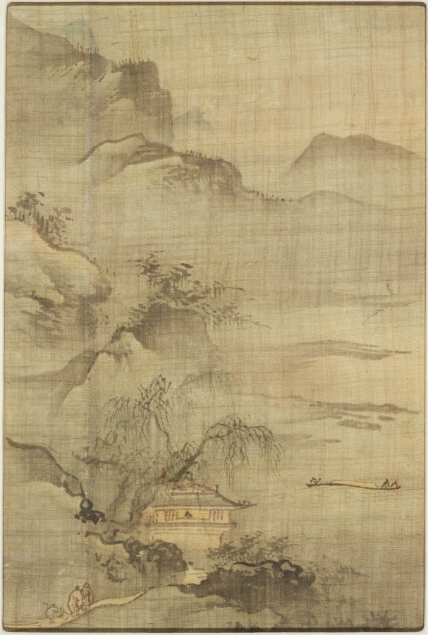
Decolonising the Self: Phenomenological Strategies
Dr Jorella Andrews
Goldsmiths, University of London

Slide 2
Convinced that there is no privileged point whence nature, history, and being itself are unveiled, or, as he says so often, that high-altitude thinking detaches us from the truth of our situation, it was necessary at the same time that he forego the illusion of seeing his own work as a spectacle …
Claude Lefort, Editor’s Foreword to Maurice Merleau-Ponty, The Visible and the Invisible, Evanston: Northwestern University Press, 1968, xxviii.

Slide 3
… [it was necessary that he] oblige himself to make his way in semi-obscurity in order to discover the interior connection of his questions, and fully comply with what demands to be said here and now without ever giving himself over to the security of a meaning already traced out, already thought.
Claude Lefort, Editor’s Foreword to Maurice Merleau-Ponty, The Visible and the Invisible, Evanston: Northwestern University Press, 1968, xxviii.

Slide 4
Making our way in semi-obscurity

Slide 5
We will come to these questions by starting ‘from below’.
Maurice Merleau-Ponty, The Structure of Behavior [1942], Boston: Beacon Press, 1963, 4.

Slide 6
Perception: “this interrogative thought which lets the perceived world be rather than posits it, before which the things form and undo themselves in a sort of gliding, beneath the yes and the no.”
Maurice Merleau-Ponty, The Visible and the Invisible: Followed by Working Notes [posthumously published in French 1964], Evanston: Northwestern UP, 1968, 102.

Slide 7
It is … a question put to what does not speak
Maurice Merleau-Ponty, The Visible and the Invisible: Followed by Working Notes [posthumously published in French 1964], Evanston: Northwestern UP, 1968, 102.

Slide 8
It directs this question to our mute life
Maurice Merleau-Ponty, The Visible and the Invisible: Followed by Working Notes [posthumously published in French 1964], Evanston: Northwestern UP, 1968, 102.

Slide 9
It addresses itself to that compound of the world and of ourselves that precedes reflection
Maurice Merleau-Ponty, The Visible and the Invisible: Followed by Working Notes [posthumously published in French 1964], Evanston: Northwestern UP, 1968, 102.

Slide 10
Phenomenological method “is a matter of describing, not of explaining or analysing”.
Merleau-Ponty, ‘Preface’, Phenomenology of Perception, London: Routledge and Kegan Paul Ltd, 1962, viii

Slide 11
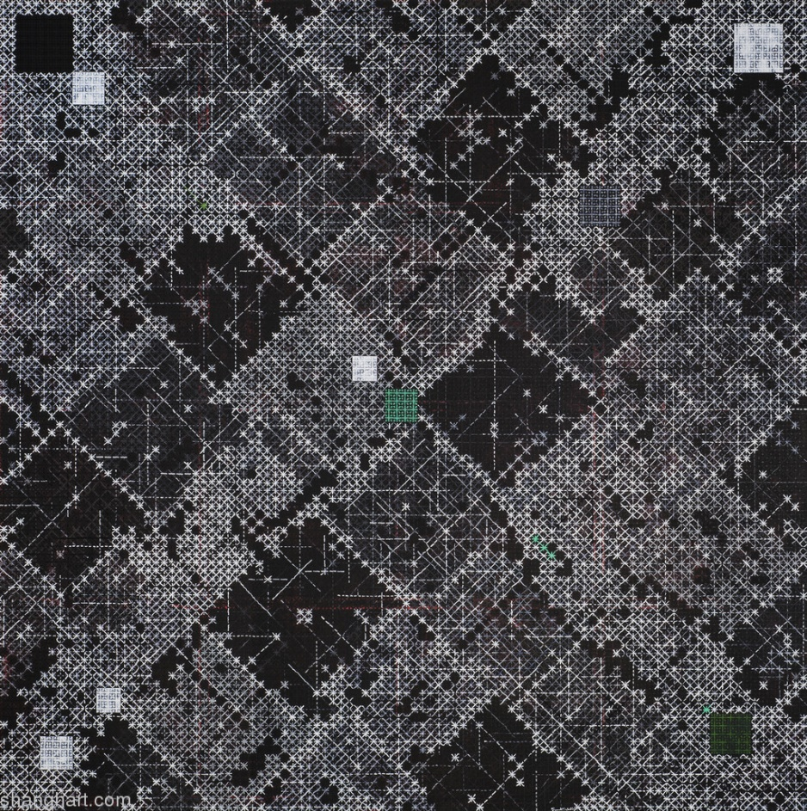
Ding Yi, 丁乙, Appearance of Crosses 2012-9, 2012, 300x300cm, Acrylic on canvas, code: DY_6912. From the exhibition What's Left to Appear, Long Museum (West Bund), Shanghai, 2015 (curated by Shane McCausland).

Slide 12
Perceiving describing, drawing

Slide 13
Kim Jongku, Mobile Landscape, 2009, steel powder, CC camera,
LED projector, paper roll, dimensions variable.

Slide 14
Landscape with Gentlemen Visiting a Scholar in a Lakeside Pavilion, Korean, Chosŏn dynasty, first half 17th century. Traditionally attributed to Kim Che (active mid-16th century); perhaps by Yi Ching (b. 1581) or Kim Myŏngguk (b. 1600)
Album leaf; ink and light color on silk
Arthur M. Sackler Museum, Louise Haskell Daly Fund and Ernest B. and Helen Pratt Dane Fund for the Acquisition of Oriental Art, 1994.108
© President and Fellows of Harvard College
The robust potential of phenomenological aesthetics

Slide 15
The robust potential of phenomenological aesthetics

Slide 16


Slide 18
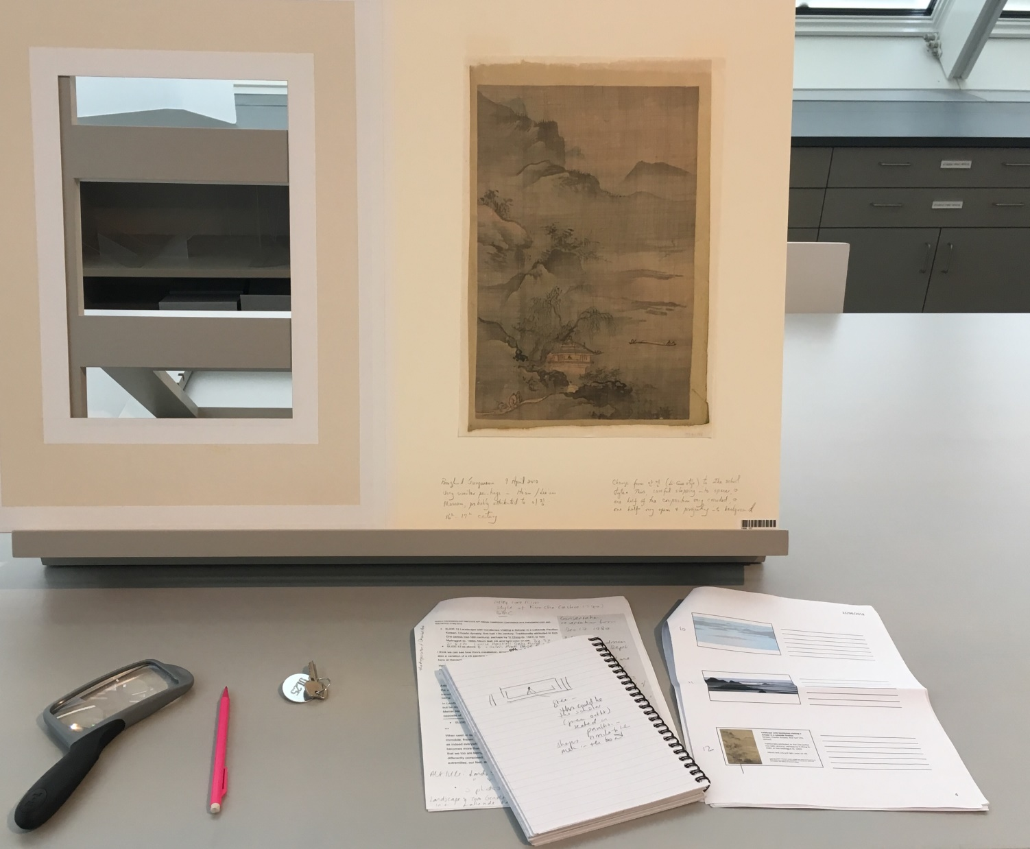
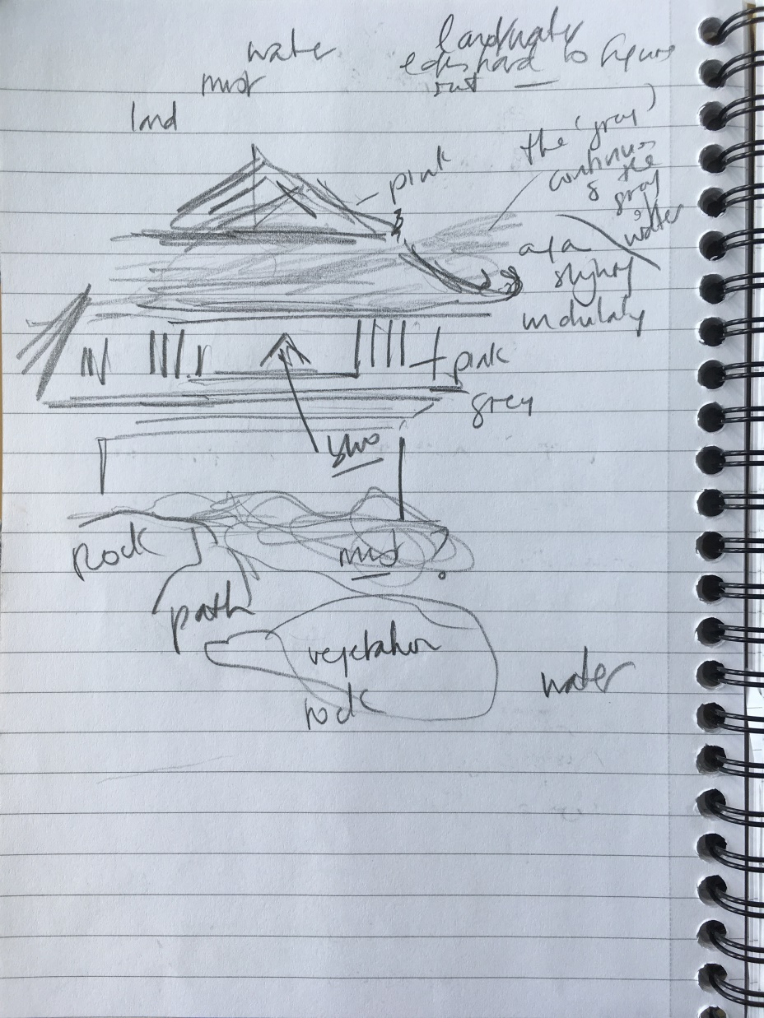

Slide 19
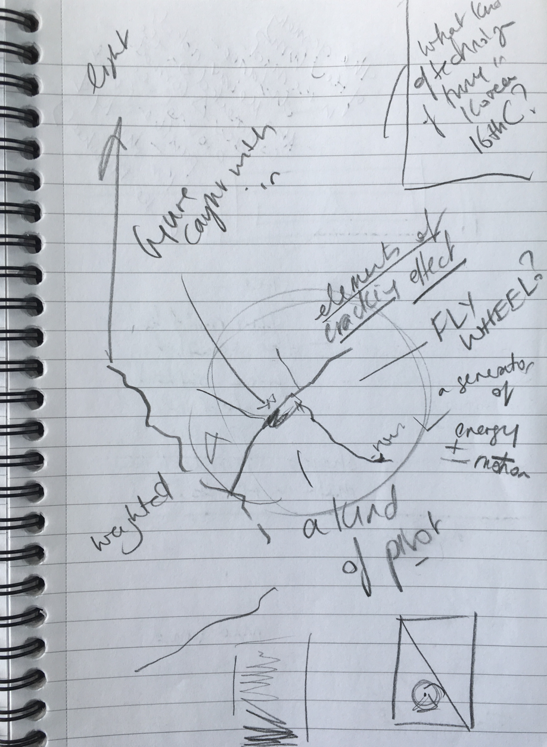

Slide 20
We live in intersubjectivity … [A] world with several compossible entrances; we are one for the others. Me-others hinge, which is common life, like me-my body hinge, which for me is not just weight, a curse, but also my flywheel. Accompany others, history, and not just endow it with sense by decision.
Maurice Merleau-Ponty, ‘For an ontology of the perceived world,’ Institution and Passivity: Course Notes from the Collége de France (1954-55), Evanston: Northwestern University Press, 2010, 134.

Slide 21
The hermeneutic decolonising circle in phenomenological research
Encounter with the research material
decolonising revision of fore-understanding
Fore-understanding of reader/researcher

Slide 22
Developing pre-critical phenomenological research strategies

Slide 23
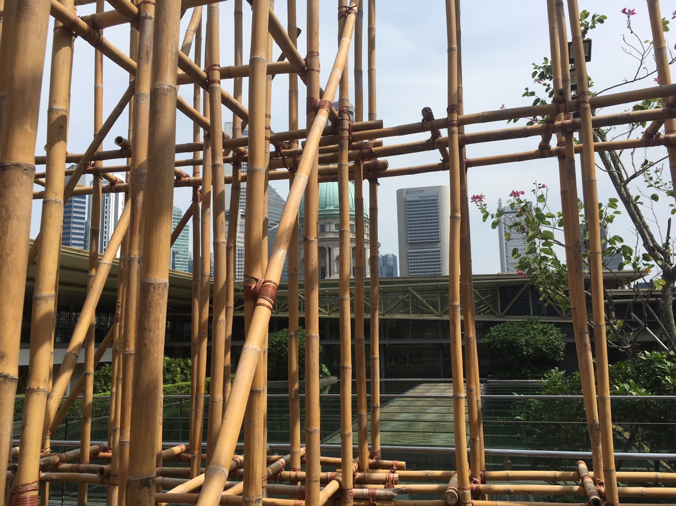
USING PHENOMENOLOGY IN CONTEMPORARY ARTS RESEARCH & PEDAGOGY
Facilitated by Jorella Andrews, Jeffrey Say & Clare Veal
Funded by the Goldsmiths/LASALLE Partnership Innovation Fund

Slide 24
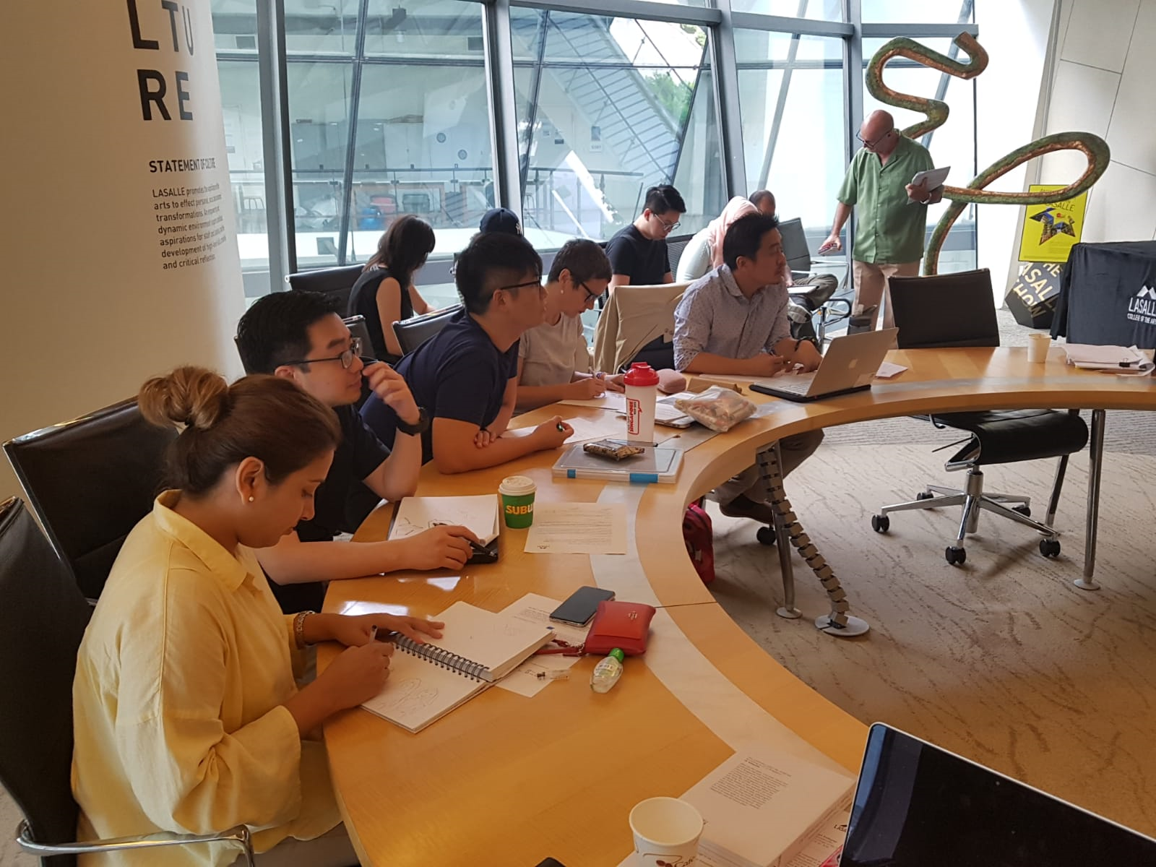

Slide 25
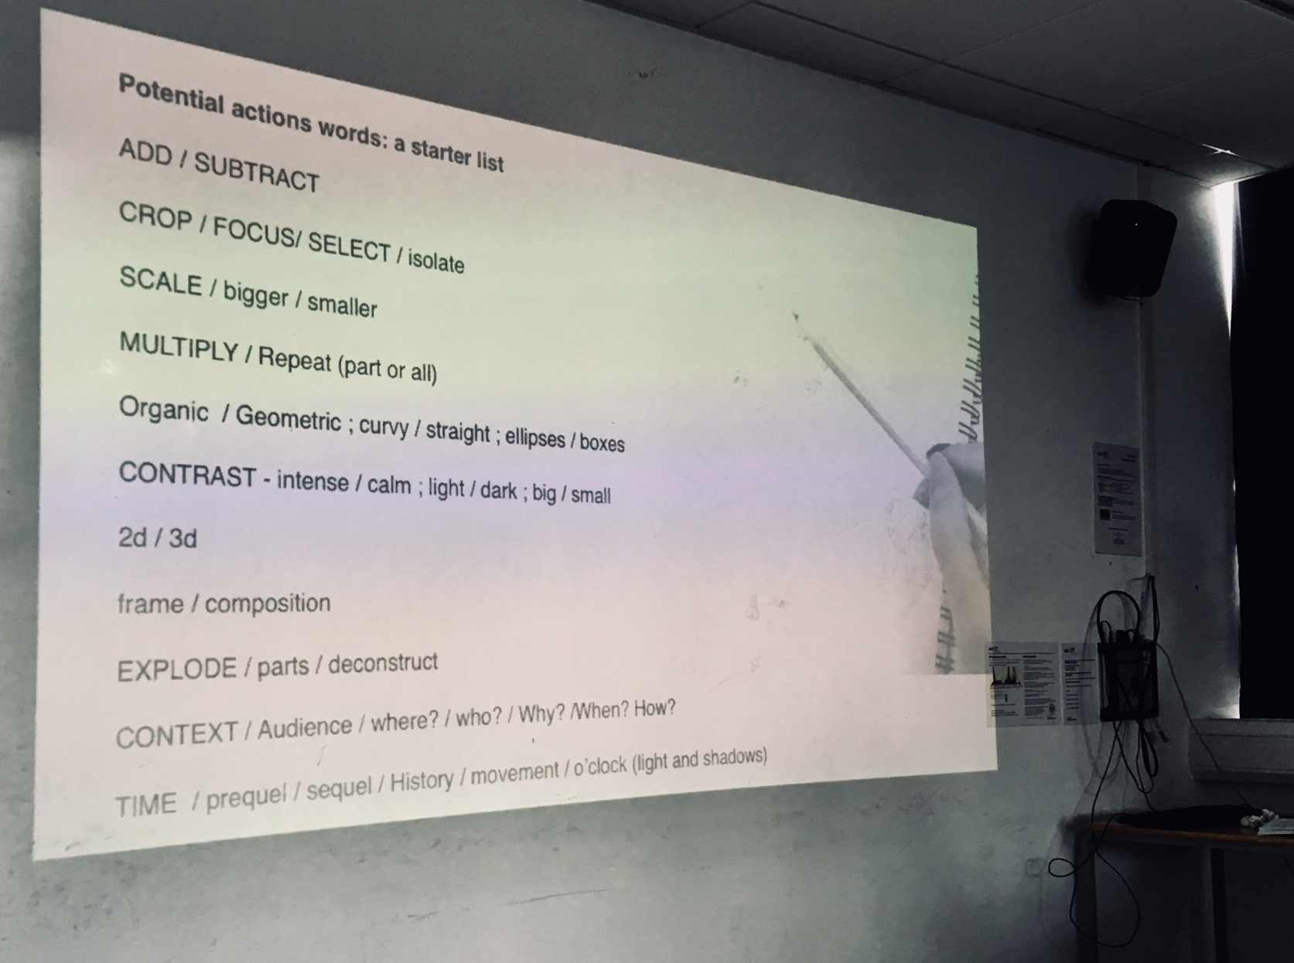
Slide from Ilga Leimanis’s workshop ‘Visualizing through Drawing’ at IAVC (International Association for Visual Culture) Conference 2018 on ‘Visual Pedagogies’

Slide 26
Add / Subtract /
Crop / Focus / Select / Isolate
Scale / Size (Bigger/Smaller)
Multiply / Repeat (part or all)
Organic / Geometric
Contrast: intense/calm; light/dark/ big/small
2D / 3D
Frame / Composition
Explode / Parts / Deconstruct
Context / audience / where? / who? / why? / when? / how?
TIME / prequel / sequel / history / movement / o’clock / light & shadow
[…]

Slide 27
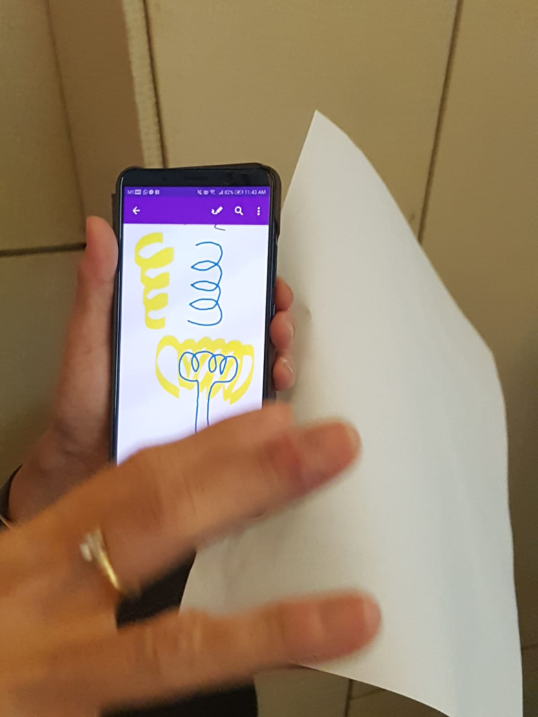
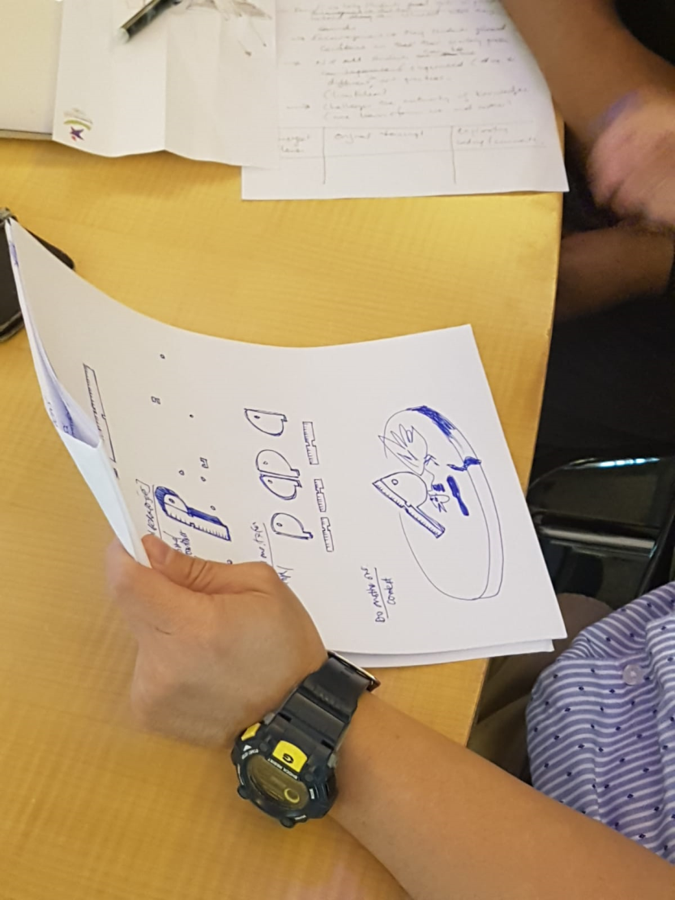

Slide 28
Description
Transcription
Ekphrasis
Paraphrase
Enactment
Mapping
Listing
[…]

Slide 29
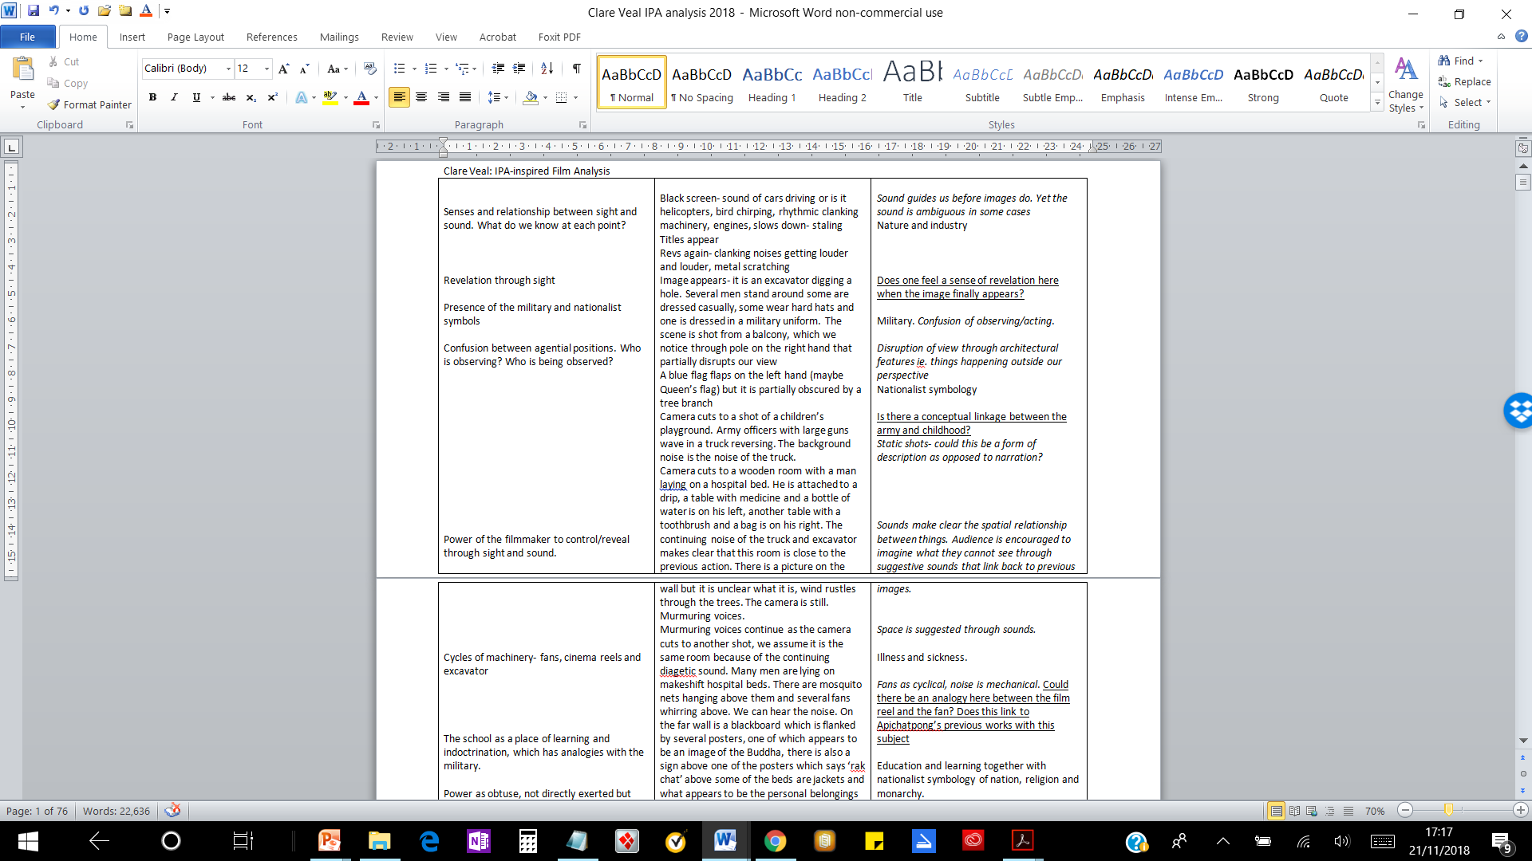
Emergent Themes / Transcript / Exploratory Comments
Adapting and experimenting with IPA (Interpretative Phenomenological Interpretation)

Slide 30
Words

Slide 31
… the philosopher knows very well that, whatever be his effort, in the best of cases it will take its place among the artefacts and products of culture, as an instance of them. If this paradox is not an impossibility, and if philosophy can speak, it is because language is not only the depository of fixed and acquired significations …

Slide 32
… because its cumulative power itself results from a power of anticipation or of prepossession, because one speaks not only of what one knows, so as to set out a display of it – but also of what one does not know, in order to know it …

Slide 33
… and because language in forming itself expresses, at least laterally, an ontogenesis of which it is a part … the words most charged with philosophy are not necessarily those that contain what they say, but rather those that most energetically open upon Being, because they more closely convey the life of the whole and make our habitual evidences vibrate until they disjoin.
Maurice Merleau-Ponty, The Visible and the Invisible: Followed by Working Notes [posthumously published in French 1964], Evanston: Northwestern UP, 1968, 102.

