Slide 1
Reticence and Resistance in New British Sculpture
Ian Hunt
Goldsmiths, Department of Art
i.hunt@gold.ac.uk

Slide 2
Some characteristics:
-- complex forms of embodiment as opposed to figuration; object-image-figure as ensemble
-- large scale and horizontally extended works inhabited by vernacular meanings and by private or enigmatic speech
-- redefinitions of abstraction as well as animus against it
-- realism and empiricism as well as metaphorical and linguistic openness.

Slide 3
1. Horizontal extensions into space

Slide 4
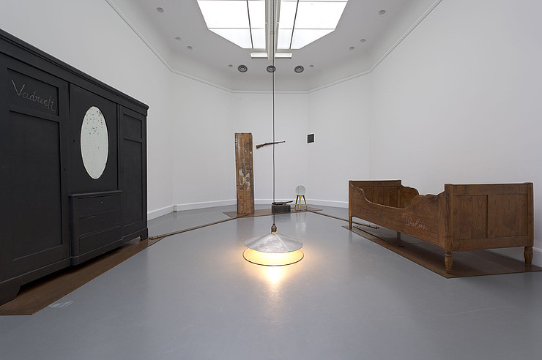
Joseph Beuys, Voglio vedere le mie montagne (I want to see my mountains) 1971
Notes:
I want to begin with this image, of Beuy’s first installation work from 1971, I want to see my mountains, as a way of thinking about the horizontal extensions of sculpture in this period and the way in which objects and spaces were beginning to be seen as one image. The occupation of space by these autobiographical, private and obscure meanings was mostly not adopted by British artists, but Beuys did have an impact on thinking about space as well as material. The horizontal exyension in this work is sheet copper.

Slide 5
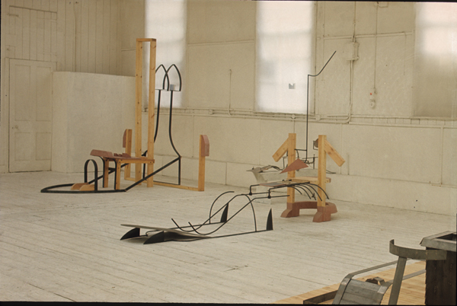
B. Catling, Royal College of Art, various sculptures, 1974
Notes:
It is not very easy to study sculpture in this period from the material remains. So much of it has vanished, and a lot was made as experiment and not expected to last. I have included these images of Brian Catling Royal College work to show a curious meeting point of somehting like Anthony Caro on one hand and Fluxus and Beuys on the other: and the strong relationship with the surrounding room. The image in many of these works was the plough.

Slide 6
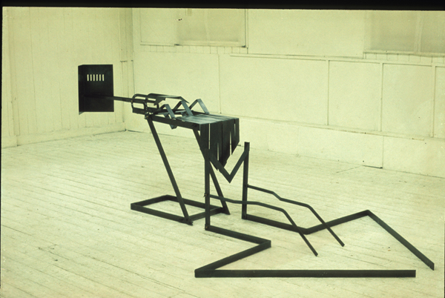
Brian Catling, sculpture from 1974, Royal College of Art

Slide 7
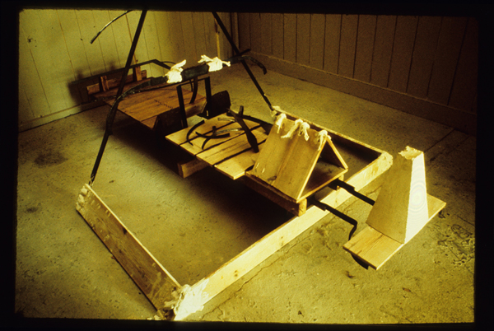
Brian Catling, Shrine, 1975, RCA. Wood, steel, carpet, plaster, light.
Notes:
Catling went on making sculpture through the 80s but it turned at a certain point the physical making that he has such an acute feeling for went entirely into temporary installations. But the horizontal extension into space remained as a frequent and evocative tactic.

Slide 8
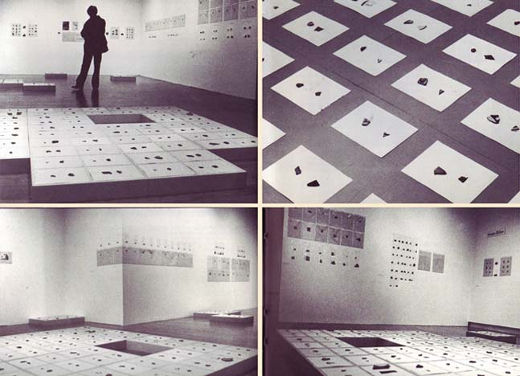
Susan Hiller, Fragments, 1976-78, installed at Museum of Modern Art, Oxford
Notes:
A different context for this pervasive formal assumption is provided by Susan Hiller’s work fragments, 1976-8. A complex work, that I cannot provide a complete account of today, comprising fragments of Pueblo pottery, the classification and recovery of aspects of anonymous art-making by women, as part of a feminist understanding. There are two points I want make. That the considerable claim on public and horizontal space has a sculptural effect. But work such as this transforms aspects of minimalism into a collective space of interpretation and enquiry for feminism and also makes the spectator him or herself a part of what is being studied.

Slide 9
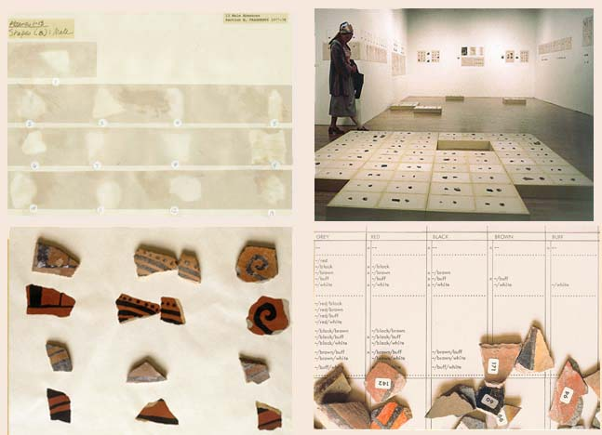
Susan Hiller, Fragments, 1976-78, installed at Museum of Modern Art, Oxford

Slide 10
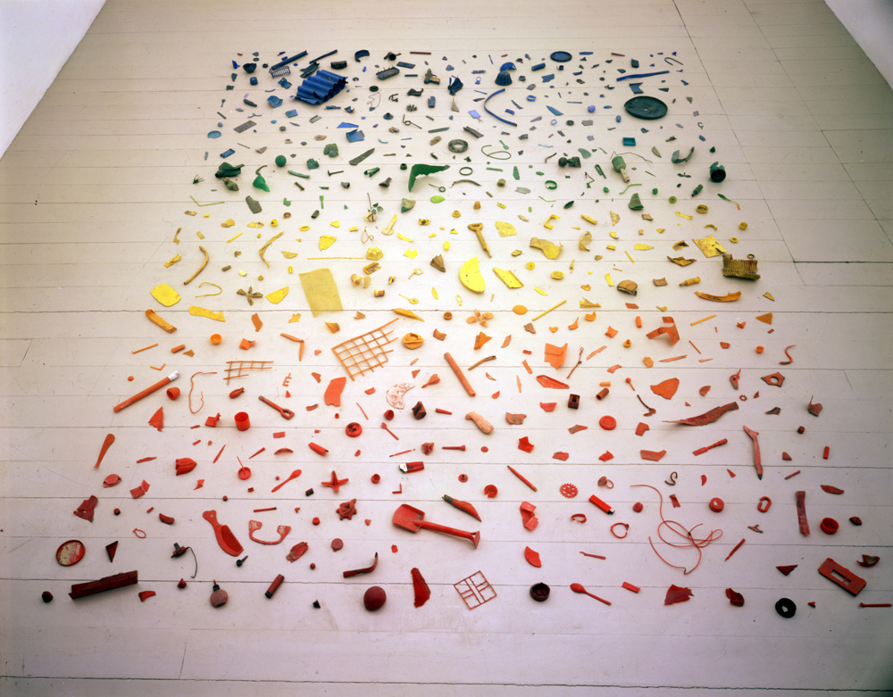
Tony Cragg, New Tones – Newton’s Stones, 1978
Notes:
The spectator of a work such as this has only the evidence of what they see and the title. There is a new economy at work: salvage, and also expertly judging how to make a work that contains all you need, that becomes almost self-interpreting. The spectator of such works becomes an empiricist, trying to understand a new landscape and their own position within it.

Slide 11
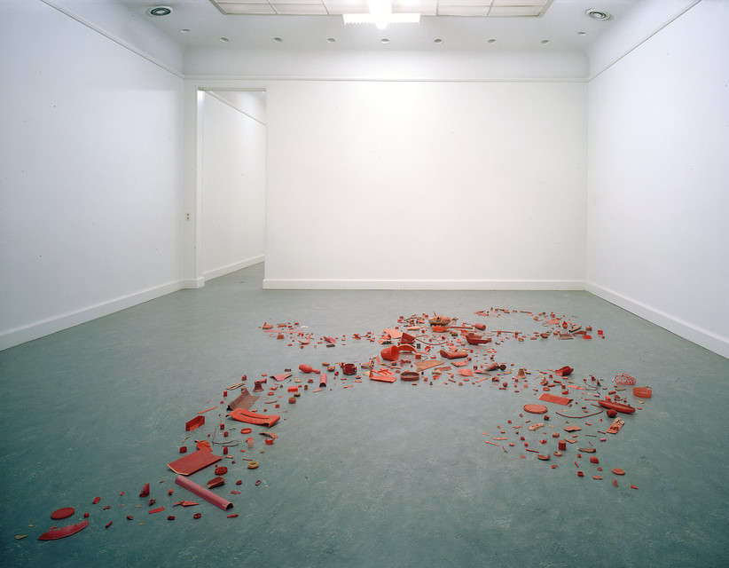
Tony Cragg, Redskin, 1980
Notes:
Whereas Hiller’s Fragments opens out the collective cultural questions of other cultures, and ourselves as others, Cragg’s anamorphic Redskin leaves the spectator essentially isolated with the routine racism of that that familiar yet disturbing word. What we see is a model figure – I played with such figures -- scaled up. No moral point is being made but the violence in culture is acknowledged and also perhaps accepted as a material fact, extending into space that is not easy to share or socialise, that’s eems predicated on the solo encounter

Slide 12
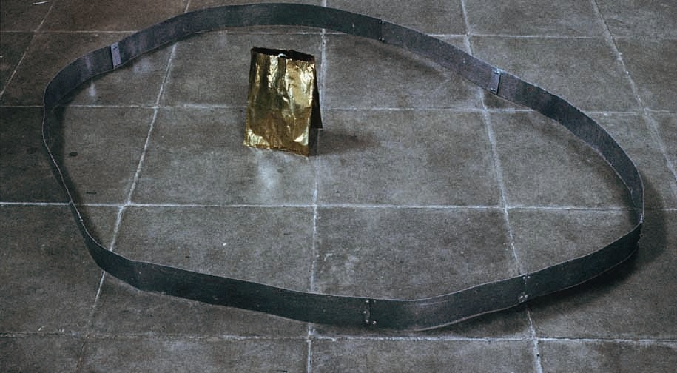
Alison Wilding, Untitled, 1980. Zinc and brass
Notes:
The solo encounter, I suggest, is important for these works. We are left somewhat isolated, examining the material facts, trying to apprehend them. Wilding became an expert manipulator of boundaries and extensions, hinting in many and varied ways at a place at the centre we cannot reach, or which forbids our approach. Here the notional centre is simply the gap between the two brass versions of paper bags, whose own interiors are suggested but cannot be pryed into.

Slide 13
2. Sculpture and embodiment
‘They must be beings, not somethings, for the inorganic could not serve for substance yielding enough to receive and resistant enough to withstand, able indeed to respond to the commerce of others. The finer, more highly finished would be so easily broken.’
(John Wilkinson, author of Proud Flesh, 1986, reflecting on his poetic practice in 1991)

Slide 14
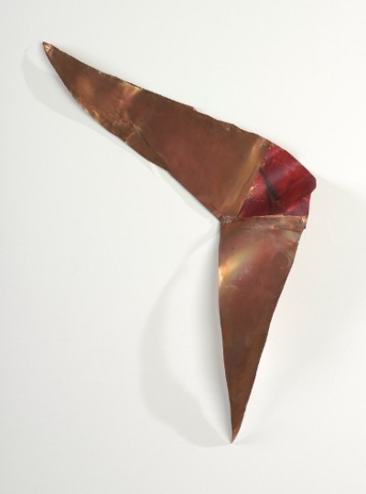
2. Sculpture and embodiment
Alison Wilding, Minge, 1982. Copper, wax. British Council
Notes:
Wilding was well aware of her own status as a female interloper in the still overwhelmingly masculine arena of sculpture. She has referred to this explicitly in relation to her education as an artist. This striking work, Minge, which I have not seen discussed anywhere, appears to be an unusually frank acknowledgment of sexual looking and violently sexist positioning; yet like Cragg’s redskin, it offers no simple moral position for the viewer to adopt before what we then again see is actually sheet copper and red wax. What kind of ‘embodiment’ – an inherited question for most sculpture -- does this suggest?

Slide 15
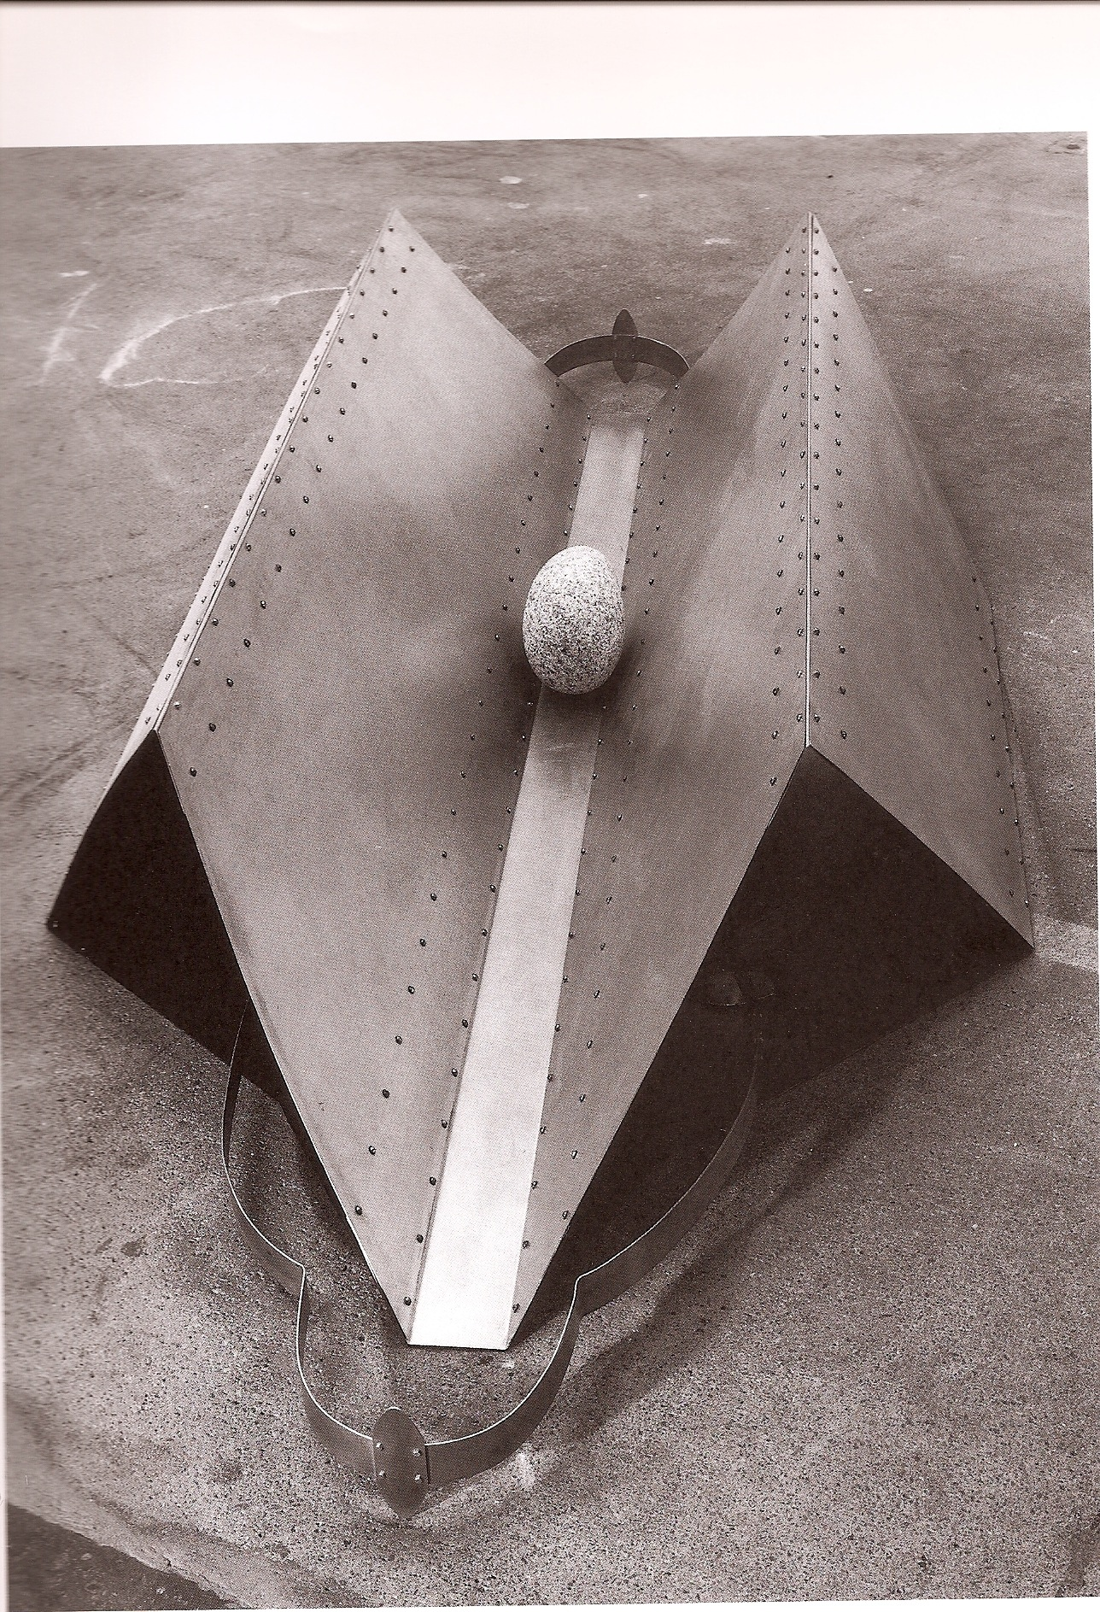
Alison Wilding, Blue Skies, 1987. Galvanised steel, Cornish granite and nickel silver
Notes:
Funerary images, tombs, a boulder, armour. Embodiment; but you put the pieces together and you still don’t have a body

Slide 16
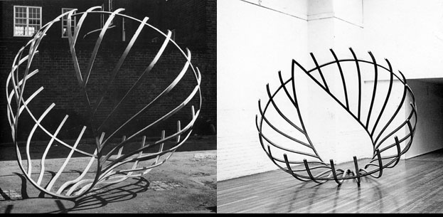
2. Complex forms of embodiment
Richard Deacon, Untitled, 1980. Laminated wood
Notes:
Openness and closedness are aspects of intersubjective life that have a gendered dimension. Here the perceptual and phenomenological attempt we make to grasp the whole figure can never be achieved. It perceives us.

Slide 17
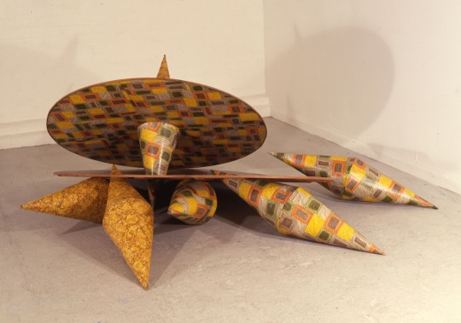
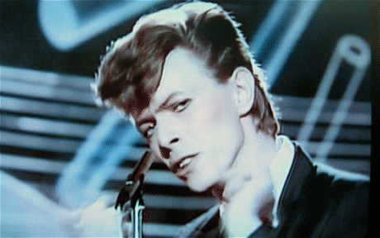
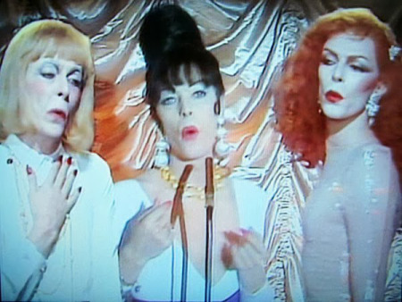
Richard Deacon, Boys and Girls (come out to play), 1982. Wood, linoleum.
David Bowie, Boys Keep Swinging, 1979

Slide 18
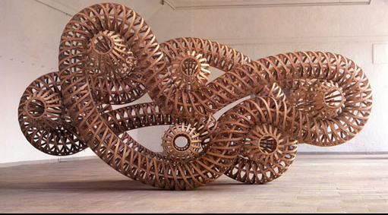
Richard Deacon, What Could make Me Feel This Way A, 1993

Slide 19
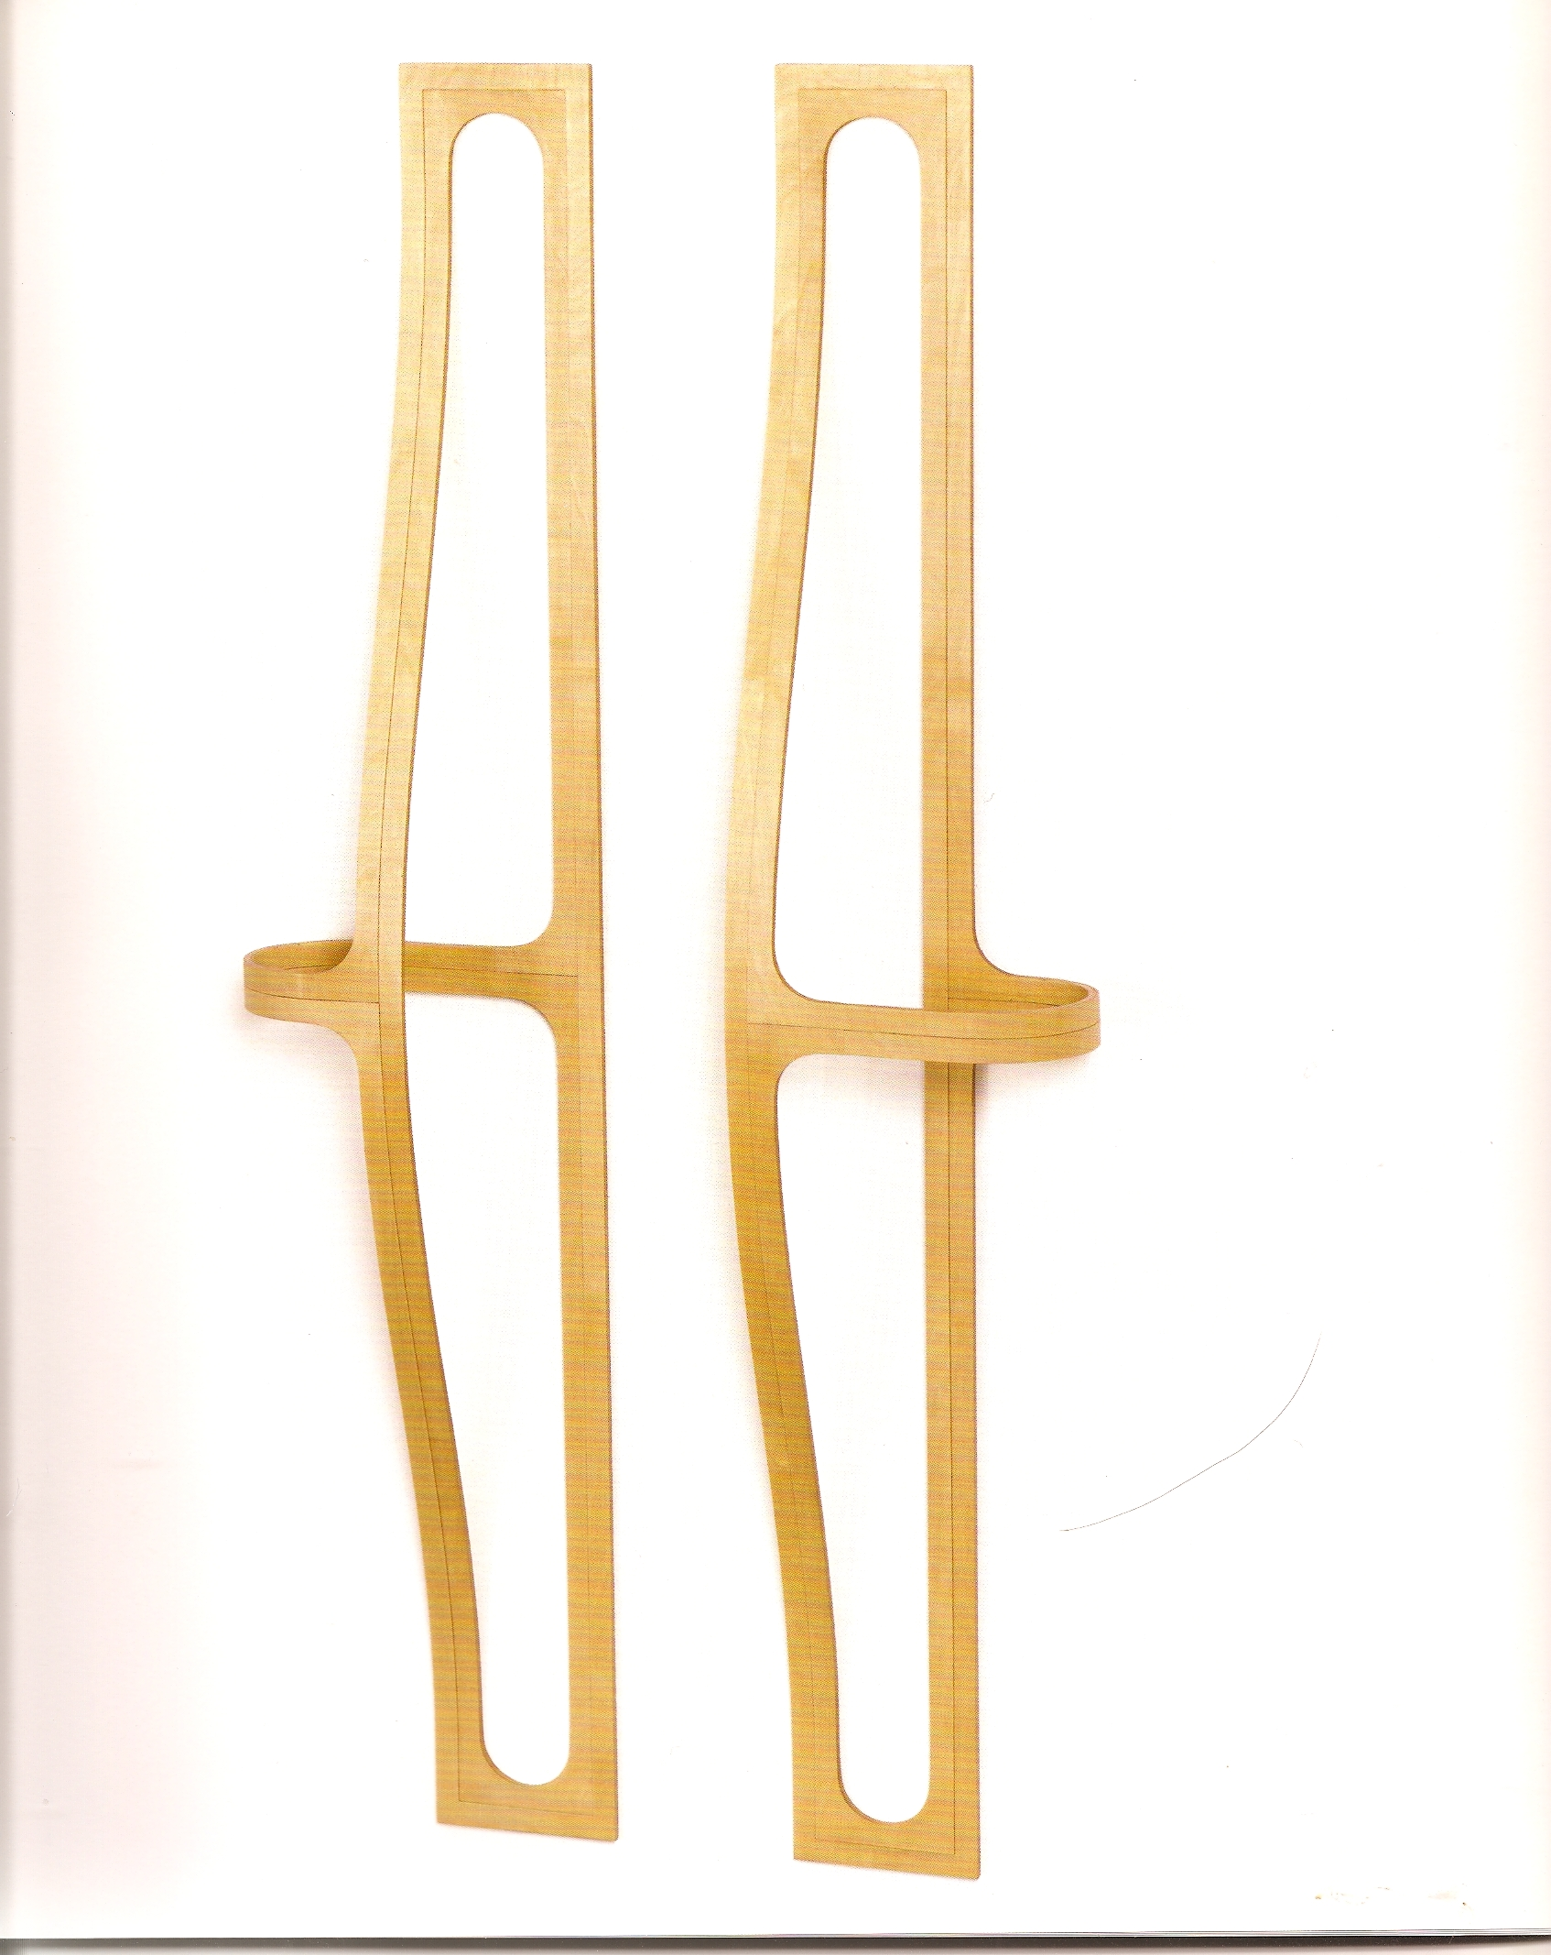
Gary Woodley,
Second Homeomorphic Pair, 1980. Wood and cellulose.

Slide 20
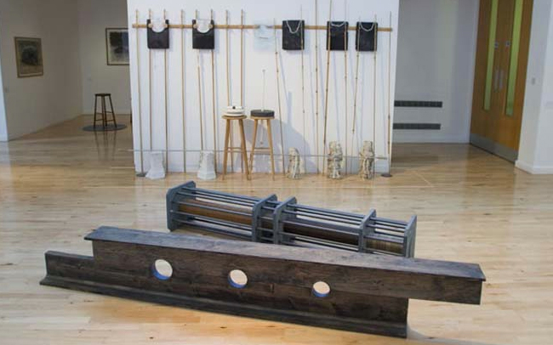
Carl Plackman, foreground: Horizontal Man, 1990; background, Anywhere to Hang Your Hat: Wedlock, 1978

Slide 21
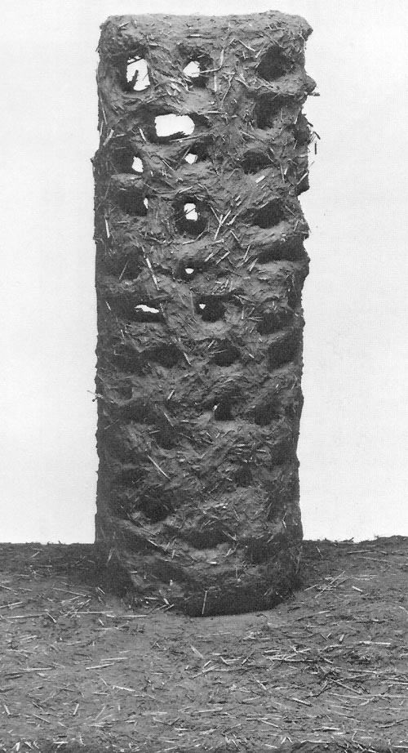
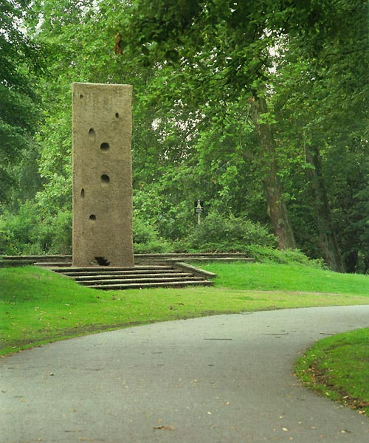
Shirazeh Houshiary,
Temple of Dawn, 1987.
Wood, willow, straw and earth.
Study and as installed at Münster Sculpture Projects. It stood till 1992.

Slide 22

3. Resistance

Slide 23
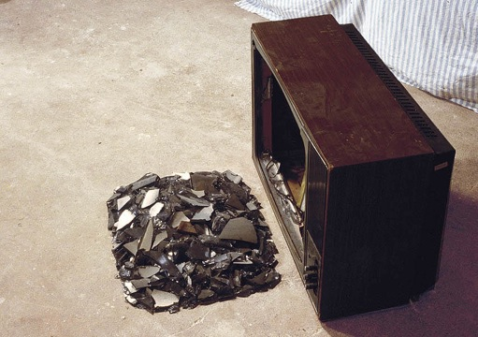
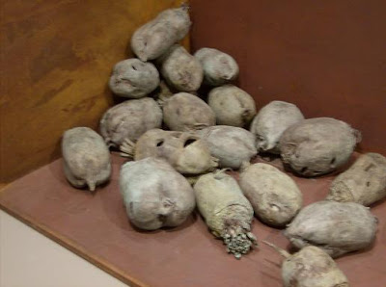
Bill Woodrow, Brixton Boys – Street Noise, 1979
Tony Cragg, Inverted Sugar Crop, 1987

Slide 24
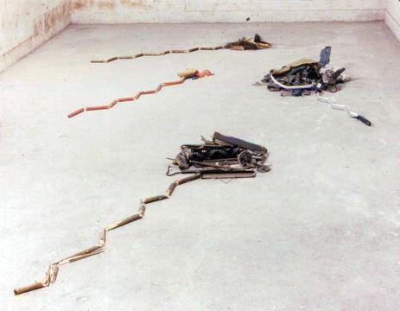
Bill Woodrow, 4 CLEANERS, 1979, -- Carpet washer, carpet sweeper, broom, vacuum cleaner. Non-extant

Slide 25
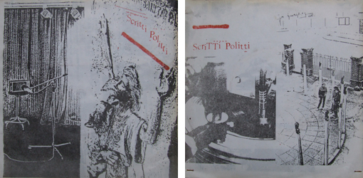
Tell her to work at Tesco's
Tell her to stay at school
Tell her what's possible - all day derision
Down at the Bull and Bush
Hopeless in Harringay
Over and above and she hasn't a clue
Twenty No. 6 and she hasn't an answer
No one wants to listen and there's no one wants to know
Someone's got a question that she doesn't want to see
Over and above and she hasn't a view
Twenty No. 6 and it isn’t a vision
No one wants to listen and there's no one wants to know
Someone with a question that she doesn't want to see
Tell her she works at Tesco's
Tell her who doesn’t know
Tell her they realise it’s all [….]
Out in the party pack
Phensic and marmalade
Frozen at six and she hasn't a clue
Frozen abroad and there isn't an answer
No one wants to listen and there's no one left to go
Someone's with a question but they've nothing left to do
Frozen at six and she hasn't a view
Frozen abroad and there isn't a notion
No one wants to listen and there's no where left to go
Someone's got a question but there’s nothing left to do
Knocking around at tea time
Up in her room, alone
Something she doesn't know - the Skank Bloc Bologna
Keeping us all alive - something in Italy
Stuck around the home and they haven't a clue
Thames at Six and it isn't an answer
Now, they've got a notion and they haven't got a hope
The Rockers in the town - the magnificent six
Rockers in the town with an overestimation
Now they've got a notion and they're working on a hope
A Euro-ruled vision and a skank in scope
Scritti Politti, ‘Skank Bloc Bologna’, St Pancras Records 7”, 1978

Slide 26
Some further listening:
David Bowie, Berlin triptych: Low, 1977; Heroes, 1977; Lodger, 1979
Scritti Politti: ‘Skank Bloc Bologna’, 1978; Songs to Remember, 1982
This Heat: ‘Twenty-Four Track Loop’, from This Heat, 1979; Deceit, 1981
The Slits: Cut, 1979, produced by Dennis Bovell; ‘Earthbeat’ and ‘Difficult Fun’, from Return of the Giant Slits, 1981
Rip, Rig + Panic, God, 1981
Fun Boy Three: ‘Our Lips Are Sealed’, 1983
The Human League, ‘The Lebanon’, 1984

Slide 27
B. Catling, from The Stumbling Block (Book Works: 1990)
‘The Stumbling Block has become a pillow to the dispossesed. It can be moulded to the need of its companion, kneaded and pummelled so as not to lose its hunched purchase on the slippery pavement. They will warble and breathe into it, it becomes their mother as their alcoholic dribble writes a sad and caustic text in its interior. This wet laser chisel entwines their lineage with fine scrollwork into the intricate memory of the city. These are the inhabitants of the boundary, our necessary shadows that are being cast further from the warmth of their twins. The block gives itself completely to these and will fierce itself against the bright sneers and plastic credit blades that shave their humanity . . . ’
Notes:
Coda: a page from the The Stumbling Block, 1990, an attempt to ‘write’ sculpture

